Slide 1
Field amplified sample stacking and focusing in nanochannels
Brian Storey (Olin College)
Jess Sustarich (UCSB)
Sumita Pennathur (UCSB)

Slide 2
FASS in microchannels
V
High cond. fluid
Low cond. fluid
High cond. fluid
+
σ=10
σ=1
σ=10
E Electric field
σ Electrical conductivity
E=10
E=1
Chien & Burgi, A. Chem 1992

Slide 3
FASS in microchannels
V
High cond. fluid
Low cond. fluid
High cond. fluid
-
-
-
+
σ=10
-
σ=1
σ=10
-
-
-
-
-
Sample ion
-
E Electric field
σ Electrical conductivity
n Sample concentration
E=10
E=1
n=1
Chien & Burgi, A. Chem 1992

Slide 4
FASS in microchannels
V
High cond. fluid
Low cond. fluid
High cond. fluid
-
-
-
+
σ=10
-
σ=1
σ=10
-
-
-
-
-
Sample ion
-
E Electric field
σ Electrical conductivity
n Sample concentration
n=10
E=10
E=1
n=1
Chien & Burgi, A. Chem 1992

Slide 5
FASS in microchannels
V
High cond. fluid
Low cond. fluid
High cond. fluid
-
-
-
+
σ=10
-
-
σ=1
σ=10
-
-
-
-
Sample ion
-
E Electric field
σ Electrical conductivity
n Sample concentration
n=10
E=10
E=1
Maximum enhancement in sample concentration is equal to conductivity ratio
Chien & Burgi, A. Chem 1992

Slide 6
FASS in microchannels
V
High cond. fluid
Low cond. fluid
High cond. fluid
-
-
-
-
-
-
-
-
-
-
-
-
-
-
-
-
-
-
-
-
-
-
-
-
-
-
-
-
-
-
-
-
+
-
-
-
-
-
-
-
-
-
-
-
-
-
-
-
-
-
-
-
-
-
-
-
-
-
-
-
-
-
-
-
-
E
dP/dx
Chien & Burgi, A. Chem 1992

Slide 7
FASS in microchannels
Low conductivity fluid
Sample ions
Simply calculate mean fluid velocity, and electrophoretic velocity.
Diffusion/dispersion limits the peak enhancement.

Slide 8
FASS in nanochannels
Same idea, just a smaller channel.
Differences between micro and nano are quite significant.

Slide 9
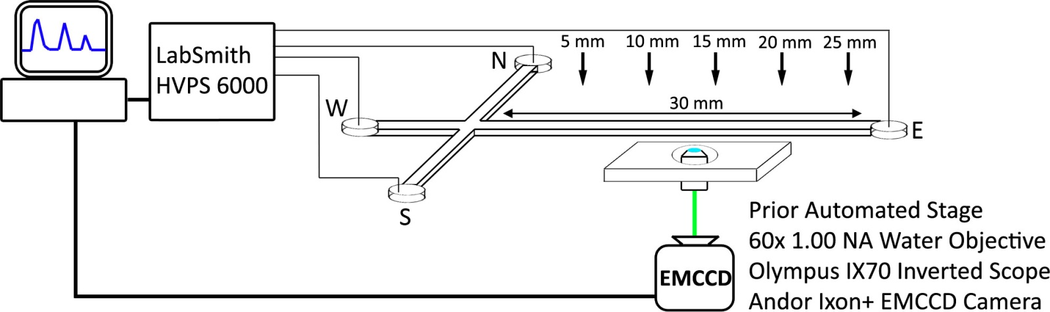
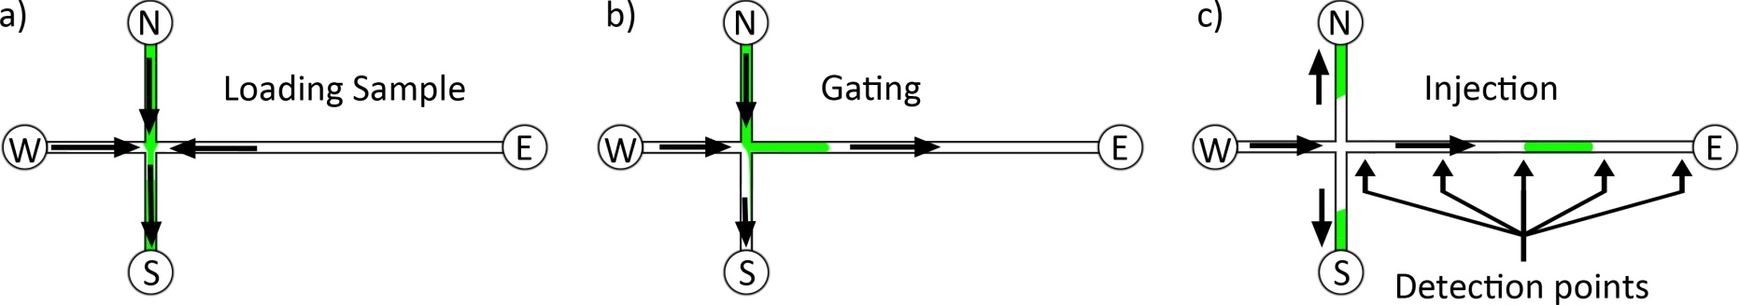
Experimental setup
2 Channels: 250 nm x7 microns
1x9 microns

Slide 10
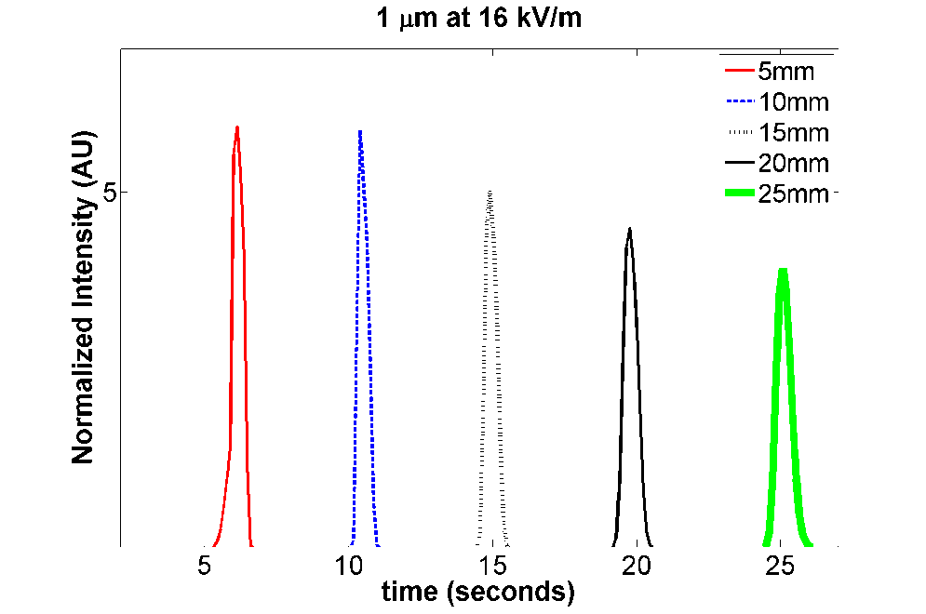
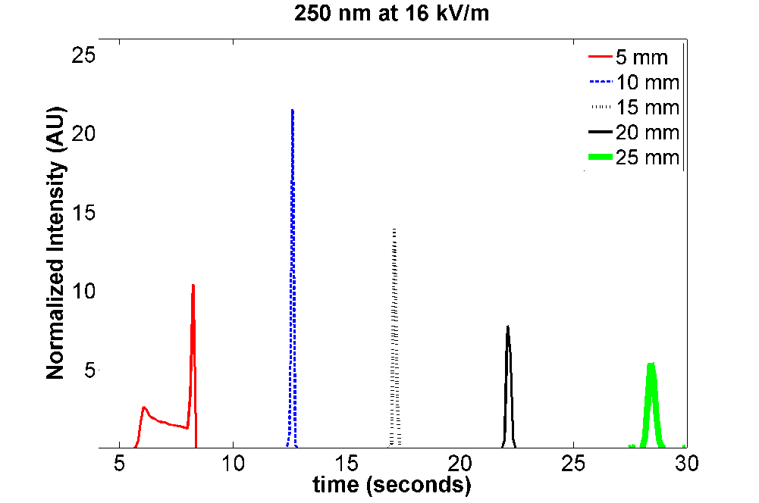
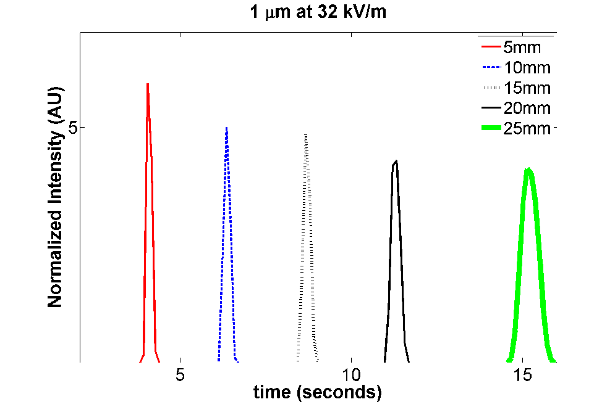
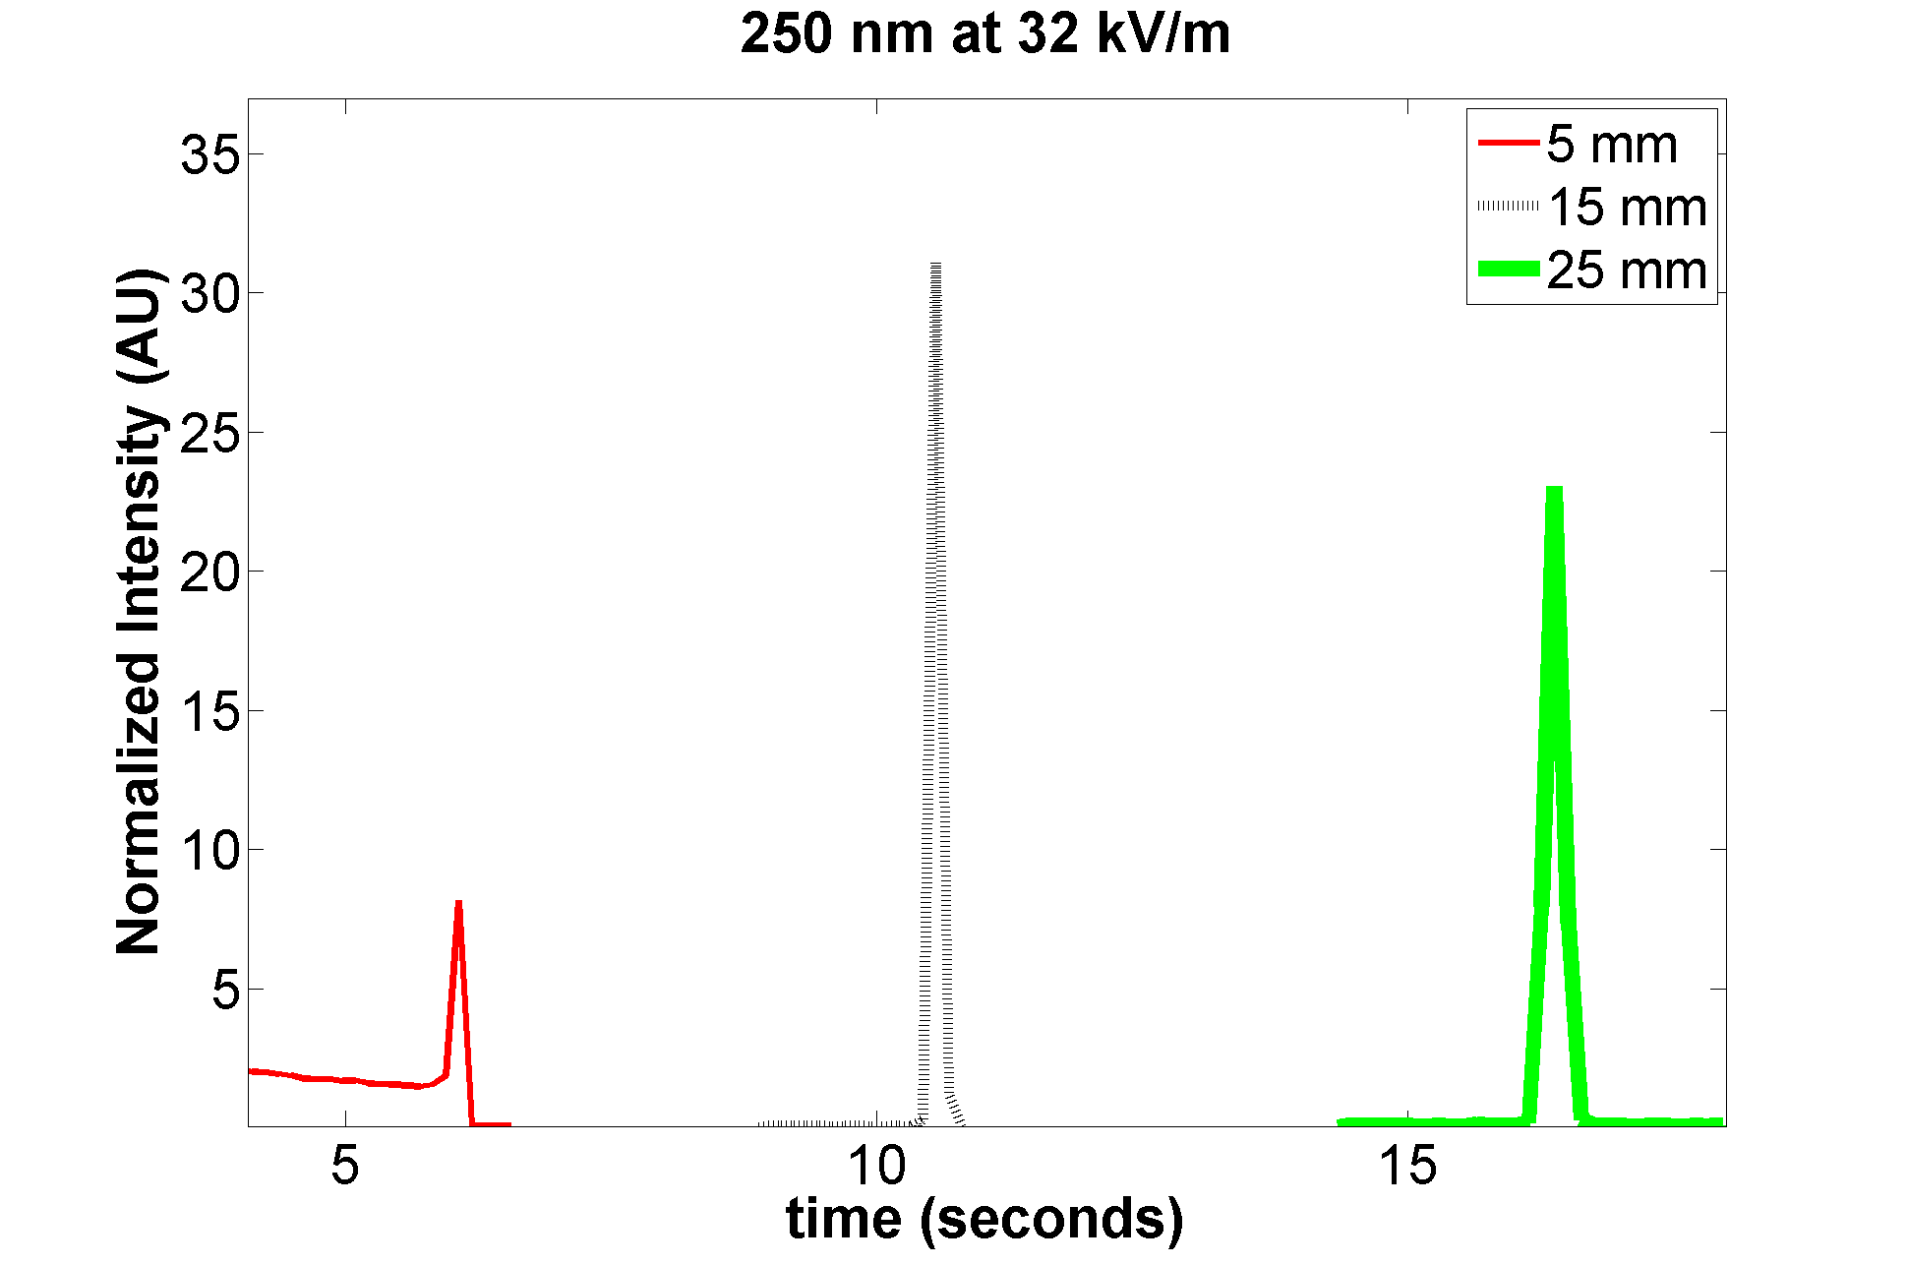
Raw data
10:1 conductivity ratio

Slide 11
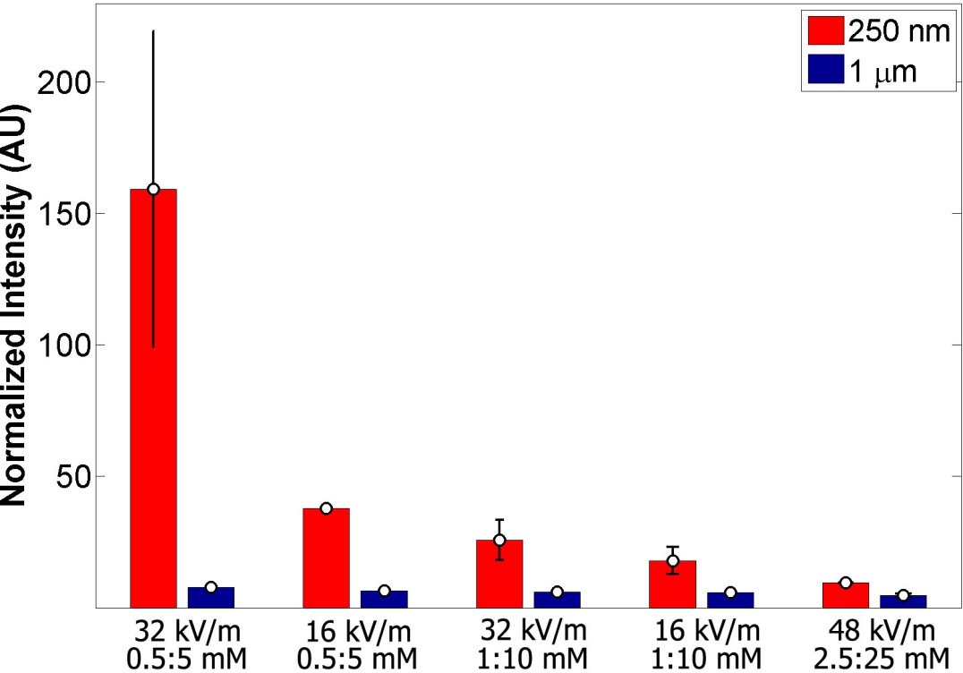
Micro/nano comparison
10

Slide 12
Observations
In 250 nm channels,
  enhancement depends on:
    Background salt concentration
    Applied electric field
  Enhancement exceeds conductivity ratio.
In 1 micron channels,
  Enhancement is constant.

Slide 13
Model
Poisson-Nernst-Planck + Navier-Stokes
Use extreme aspect ratio to get 1D equations – assuming local electrochemical equilibrium (aspect ratio is equivalent to a tunnel my height from Boston to NYC)
Yields simple equations for propagation of the low conductivity region and sample.

Slide 14
Model – yields simple jump conditions for the propagation of interfaces
Flow is constant down the channel
Current is constant down the channel.
Conservation of electrical conductivity.
Conservation of sample species.
u is velocity
ρ is charge density
E is electric field
b is mobility
σ is electrical conductivity
n is concentration of sample
Bar denotes average taken across channel height

Slide 15
Characteristics
1 micron
250 nm
Sample ions
Low conductivity
Sample ions
Low conductivity
Enhancement =13
Enhancement =125
10:1 Conductivity ratio, 1:10mM concentration

Slide 16
Why is nanoscale different?
y/H
High cond.
Low cond.
High cond.
y/H
High cond.
High cond.
Low cond.
y/H
Low cond.
High cond.
High cond.
X (mm)

Slide 17
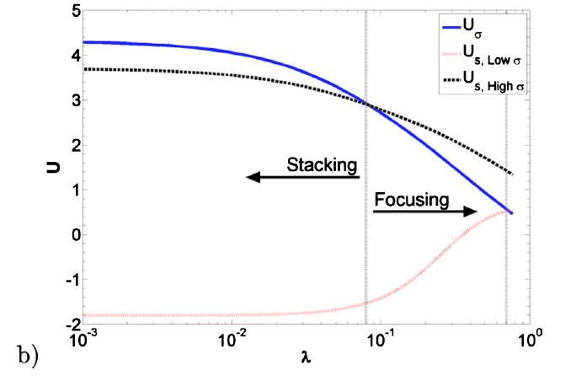
Focusing
High cond. buffer
Low cond. buffer
High cond. buffer
Uσ
Us,high
Us,low
-
-
Uσ
Us,high
Us,low
Debye length/Channel Height

Slide 18
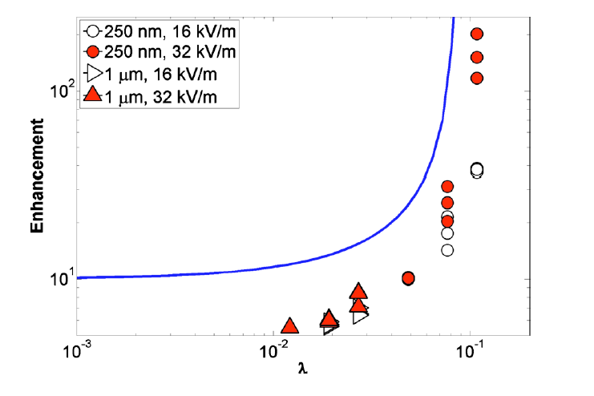
Simple model to experiment
Debye length/Channel Height
Simple model – 1D, single channel, no PDE, no free parameters

Slide 19
Towards quantitative agreement
Add diffusive effects (solve a 1D PDE)
All four channels and sequence of voltages is critical in setting the initial contents of channel, and time dependent electric field in measurement channel.

Slide 20
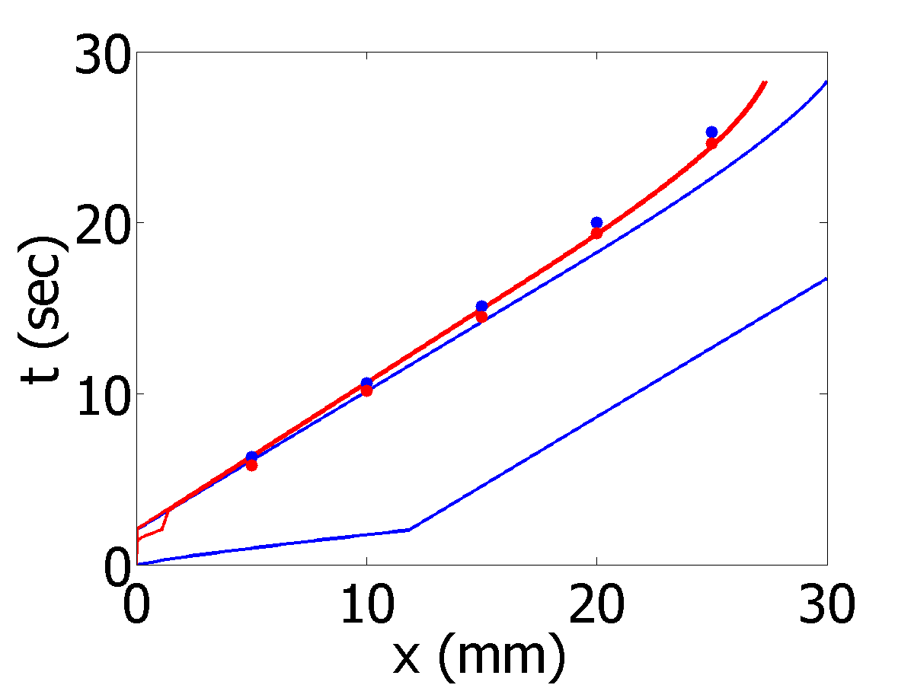
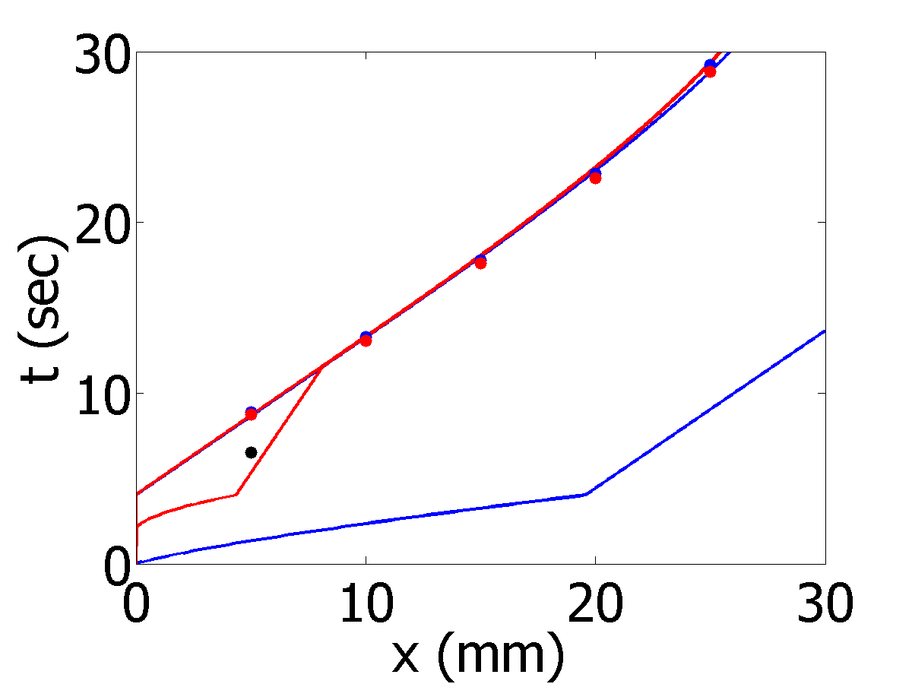
Characteristics – 4 channels
1 micron channel
250 nmchannel
Red – location of sample
Blue – location of low conductivity fluid

Slide 21
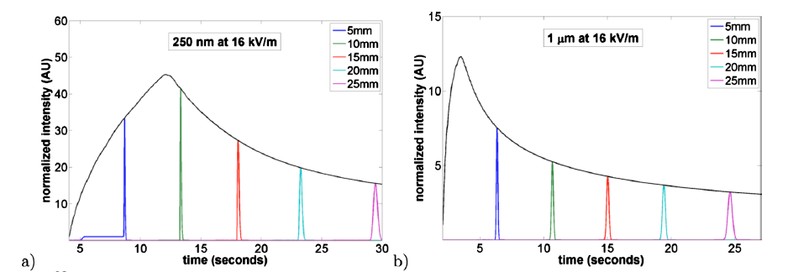
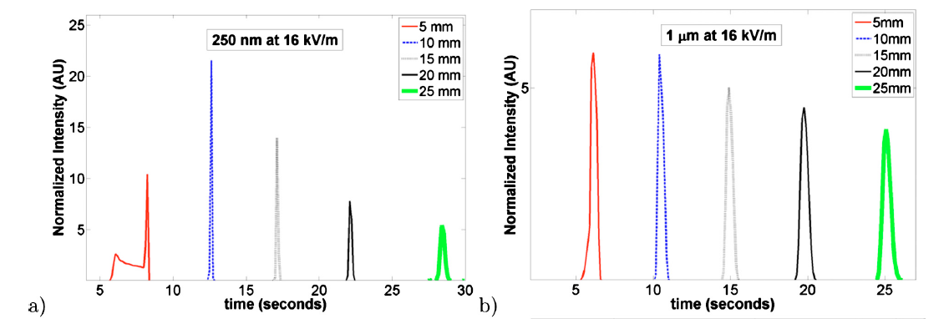
Model vs. experiment (16 kV/m)
250 nm
1 micron
Model
Exp.

Slide 22
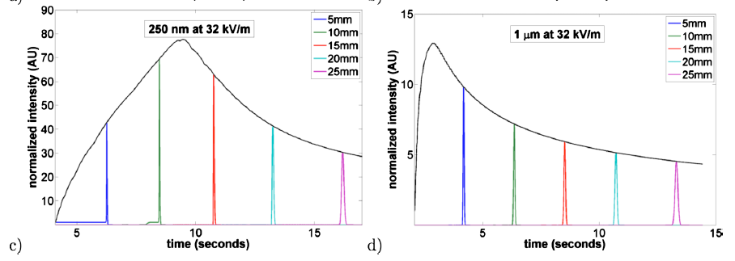
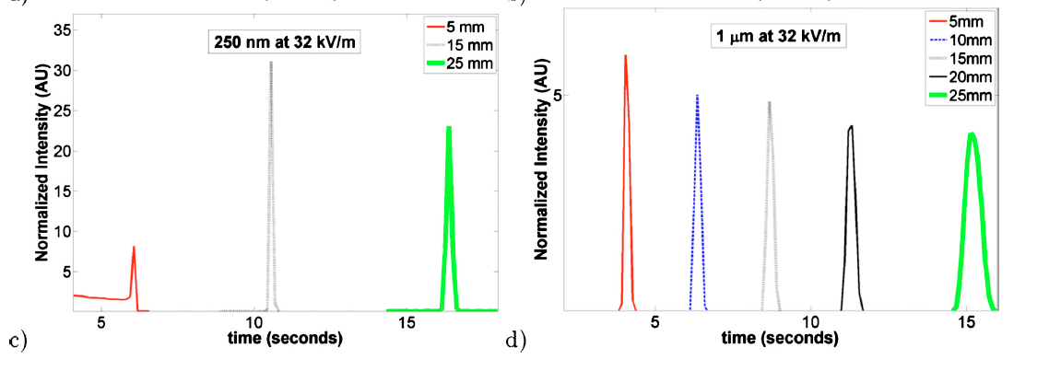
Model vs. experiment (32 kV/m)
250 nm
1 micron
Model
Exp.

Slide 23
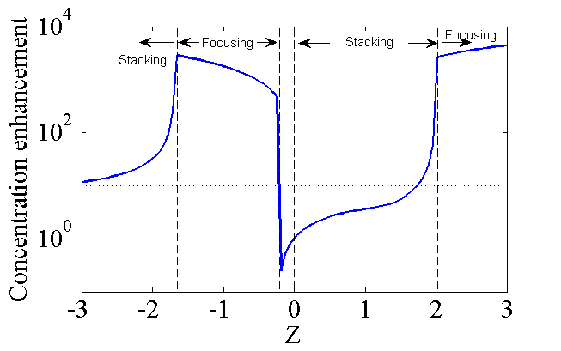
Untested predictions

Slide 24
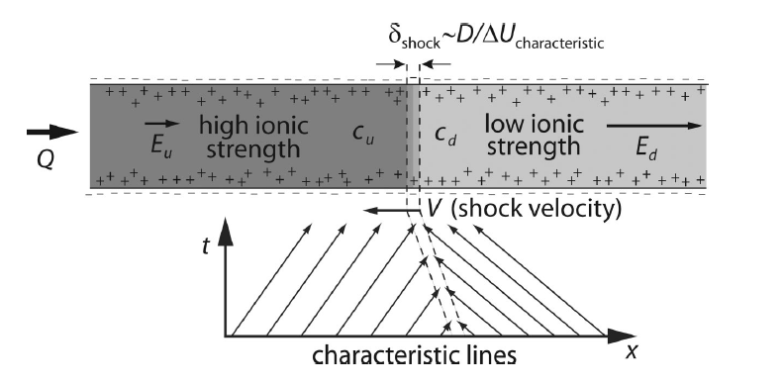
Shocks in background concentration
Mani, Zangle, and Santiago. Langmuir, 2009

Slide 25
Conclusions
Nanochannel FASS shows dependence on electrolyte concentration, channel height, electric field, sample valence, etc – not present in microchannels.
Nanochannels outperform microchannels in terms of enhancement.
Nanochannel FASS demonstrates a novel focusing mechanism.
Double layer to channel height is key parameter.
Model is very simple, yet predicts all the key trends with no fit parameters.
Future work
  What is the upper limit?
  Can it be useful?
  More detailed model – better quantitative agreement.

Slide 26
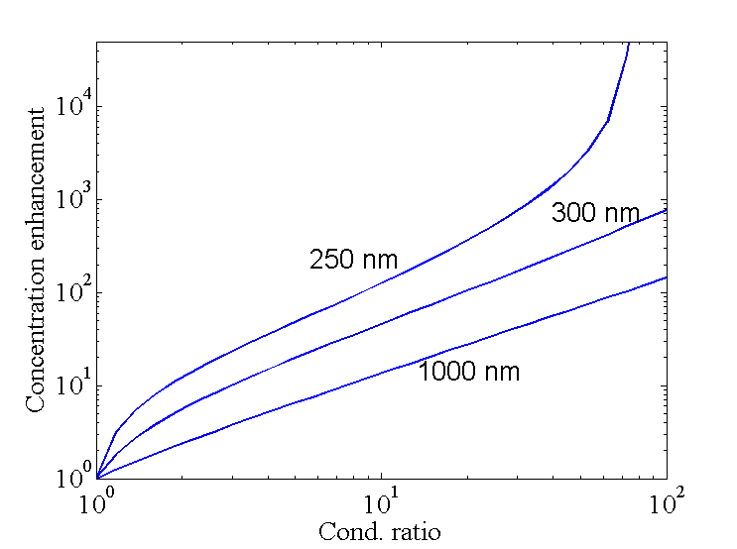
Untested predictions

