Slide 1
Modeling flow and transport in nanofluidic devices
Brian Storey (Olin College)
Collaborators:
Jess Sustarich (Graduate student, UCSB)
Sumita Pennathur (UCSB)

Slide 2
First…. the 30,000 foot view

Slide 3
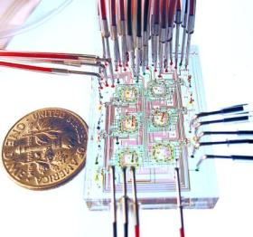
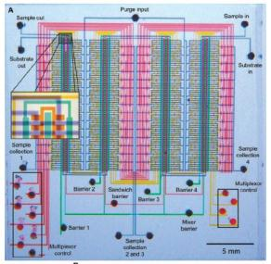
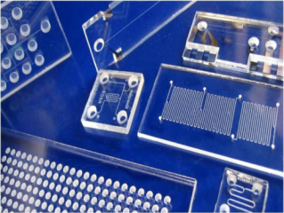
Microfluidics – Lab on a chip ca. 1990
Microfluidics deals with the behavior, precise control and manipulation of fluids that are geometrically constrained to a small, typically sub-millimeter, scale. (Wikipedia)
Micronit
Stephen Quake, Stanford
Thorsen et al, Science, 2002

Slide 4
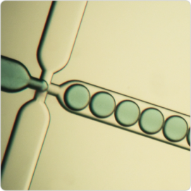
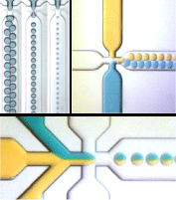
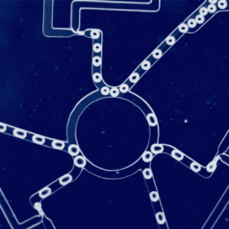
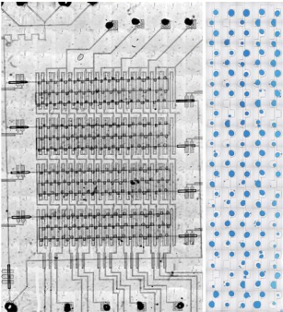
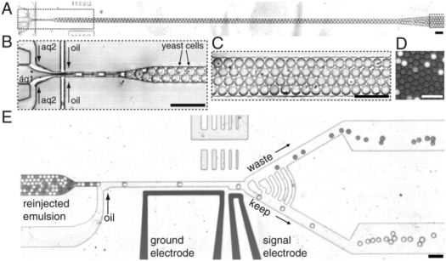
Dolomite
Dolomite
Prakash & Gershenfeld, Science, 2007
Agresti et al, PNAS 2010
Seth Fraden, Brandeis

Slide 5
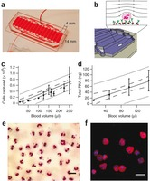
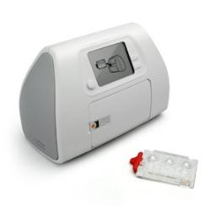
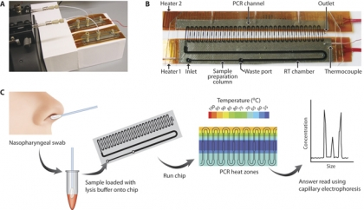
Circulating tumor cells, MGH
Neutrophil Genomics, MGH
Kotz et al, Nature Med. 2010
Nagrath et al, Nature 2007
H1N1 Detection, Klapperich BU
CD4 cell count, Daktari Diagnostics

Slide 6
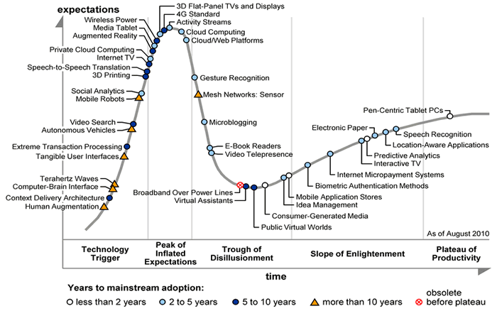
“Hype cycle”
Microfluidics?
Nanofluidics?
Gartner Inc.

Slide 7
Nanofluidics
Nanofluidics is the study of the behavior, manipulation, and control of fluids that are confined to structures of nanometer (typically 1-100 nm) characteristic dimensions. Fluids confined in these structures exhibit physical behaviors not observed in larger structures, such as those of micrometer dimensions and above, because the characteristic physical scaling lengths of the fluid, (e.g. Debye length, hydrodynamic radius) very closely coincide with the dimensions of the nanostructure itself. (Wikipedia)

Slide 8
Nanofluidics is interesting because…
Faster, cheaper, better– analogy to microelectronics.
“the study of nanofluidics may ultimately become more a branch of surface science than an extension of microfluidics.” George Whitesides

Slide 9
Some background.
Flow in a channel.

Slide 10
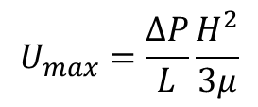
Pressure driven flow is difficult at the nanoscale
Pressure driven flow of a Newtonian fluid between parallel plates has a parabolic velocity profile. The fluid velocity is zero at the walls and is maximum along the centerline.
High pressure
H
Low pressure
$$U_{max}=\frac{ΔP}{L}\frac{H^{2}}{3μ}$$
About 100 atmospheres of pressure needed
to drive reasonable flow in typical channels

Slide 11
The electric double layer
Glass
Salt water
-
+
+
-
+
+
Glass + water
-
+
-
+
+
-
+
-
+
+
+
-
+
-
-
-
-
+
-
+
+
+
+
-
-
+
+
-
+
+
+
-
+
-
-
Debye length is the scale where concentrations of positive and negative ions are equal.
counter-ions
co-ions

Slide 12
Electroosmosis (200th anniversary)
-
+
-
-
+
+
+
-
+
-
+
-
-
-
+
+
+
+
-
+
+
+
+
-
+
+
+
-
+
+
+
+
-
+
+
-
+
+
-
+
-
-
+
+
+
-
+
+
+
+
+
+
-
-
+
+
-
+
-
+
+
+
Electric field
-
-
+
+
+
+
+
+
+
-
-
+
-
+
-
+
-
+
+
-
+
-
+
+
+
-
-
+

Slide 13
Double layers are typically small ~10 nm
Velocity profile in a 10 micron channel
Helmholtz-Smolochowski

Slide 14
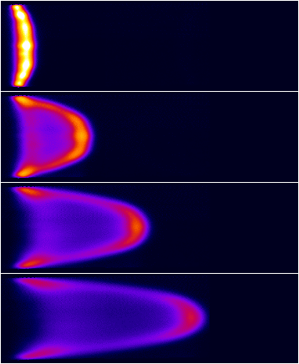
Electroosmosis-experiments
Pressure-driven
Electrokinetic
Molho and Santiago, 2002

Slide 15
The specific problem – Detection.

Slide 16
FASS in microchannels
V
High cond. fluid
Low cond. fluid
High cond. fluid
+
σ=10
σ=1
σ=10
E Electric field
σ Electrical conductivity
E=10
E=1
Chien & Burgi, A. Chem 1992

Slide 17
FASS in microchannels
V
High cond. fluid
Low cond. fluid
High cond. fluid
-
-
-
+
σ=10
-
σ=1
σ=10
-
-
-
-
-
Sample ion
-
E Electric field
σ Electrical conductivity
n Sample concentration
E=10
E=1
n=1
Chien & Burgi, A. Chem 1992

Slide 18
FASS in microchannels
V
High cond. fluid
Low cond. fluid
High cond. fluid
-
-
-
+
σ=10
-
σ=1
σ=10
-
-
-
-
-
Sample ion
-
E Electric field
σ Electrical conductivity
n Sample concentration
n=10
E=10
E=1
n=1
Chien & Burgi, A. Chem 1992

Slide 19
FASS in microchannels
V
High cond. fluid
Low cond. fluid
High cond. fluid
-
-
-
+
σ=10
-
-
σ=1
σ=10
-
-
-
-
Sample ion
-
E Electric field
σ Electrical conductivity
n Sample concentration
n=10
E=10
E=1
Maximum enhancement in sample concentration is equal to conductivity ratio
Chien & Burgi, A. Chem 1992

Slide 20
FASS in microchannels
V
High cond. fluid
Low cond. fluid
High cond. fluid
-
-
-
-
-
-
-
-
-
-
-
-
-
-
-
-
-
-
-
-
-
-
-
-
-
-
-
-
-
-
-
-
+
-
-
-
-
-
-
-
-
-
-
-
-
-
-
-
-
-
-
-
-
-
-
-
-
-
-
-
-
-
-
-
-
E
dP/dx
Chien & Burgi, A. Chem 1992

Slide 21
FASS in microchannels
Low conductivity fluid
Sample ions
Simply calculate mean fluid velocity, and electrophoretic velocity.
Diffusion/dispersion limits the peak enhancement.

Slide 22
FASS in nanochannels
Same idea, just a smaller channel.
Differences between micro and nano are quite significant.

Slide 23
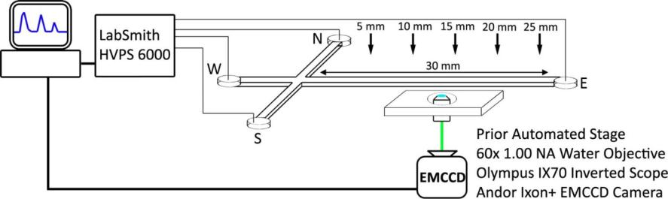
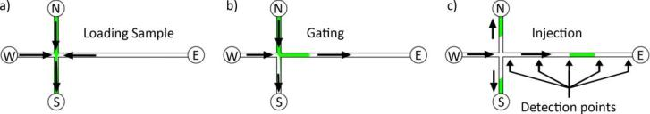
Experimental setup
2 Channels: 250 nm x7 microns
1x9 microns

Slide 24
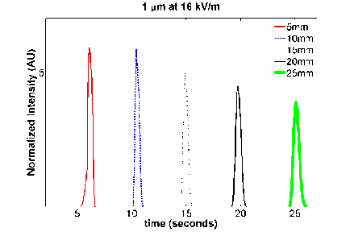
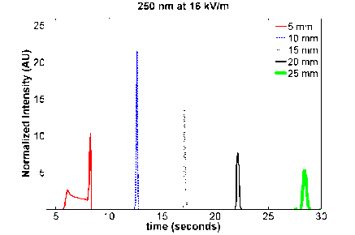
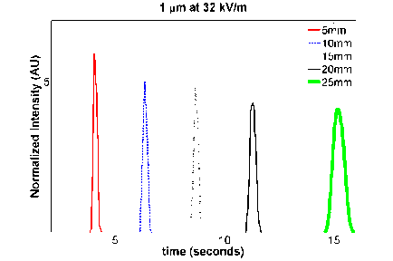
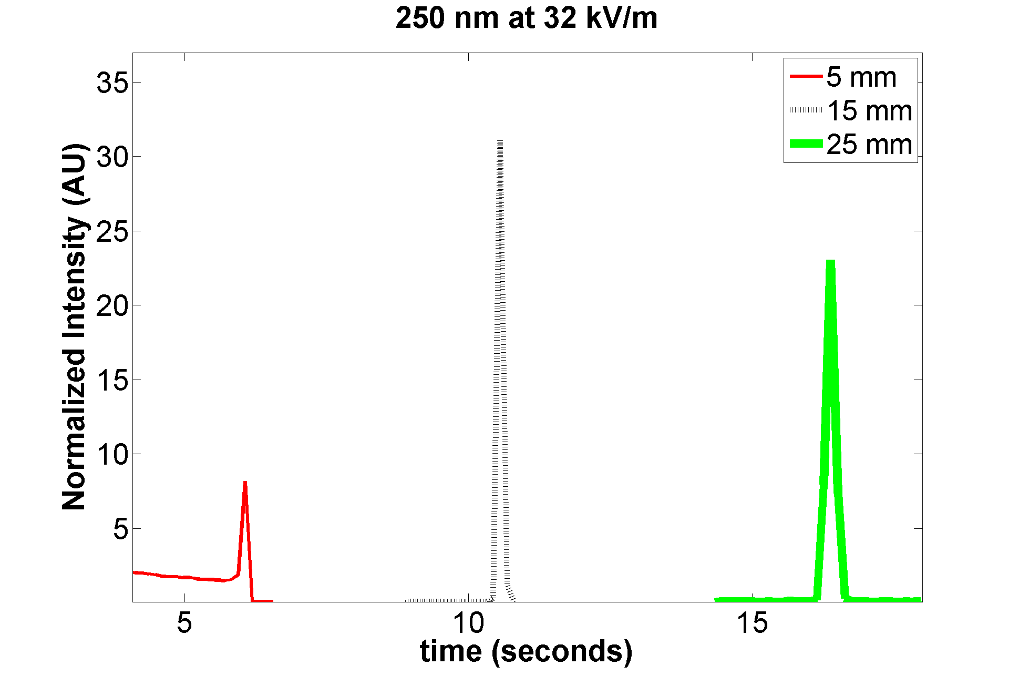
Raw data
10:1 conductivity ratio

Slide 25
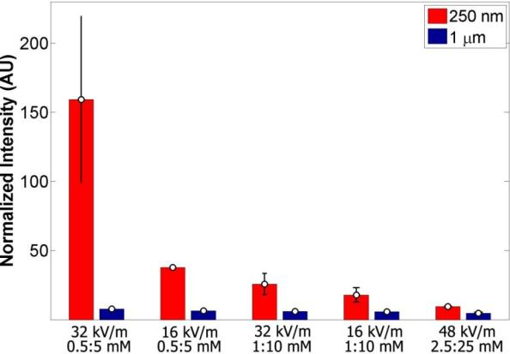
Micro/nano comparison
10

Slide 26
Model
Poisson-Nernst-Planck + Navier-Stokes
Use extreme aspect ratio to get simple equations (strip of standard paper 1/8 inch wide, 40 feet long)

Slide 27

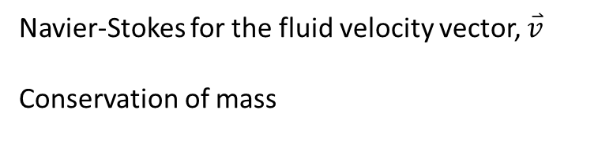




Full formulation
100+ years old
$$\frac{∂c^{+}}{∂t}=∇⋅\left(−\overset{⃑}{v}c^{+}+D \left(∇c^{+}+\frac{e}{kT}c^{+}∇φ\right)\right)$$
$$\frac{∂c^{−}}{∂t}=∇⋅\left(−\overset{⃑}{v}c^{−}+D \left(∇c^{−}−\frac{e}{kT}c^{−}∇φ\right)\right)$$
$$\frac{∂n}{∂t}=∇⋅\left(−\overset{⃑}{v}n+D_{n} \left(∇n+\frac{z_{n}e}{kT}n∇φ\right)\right)$$
$$ε∇^{2}φ=−ρ=e(c^{+}−c^{−})$$
$$0=−∇P+μ∇^{2}\overset{⃑}{v}−ρ∇φ$$
$$∇⋅\overset{⃑}{v}=0$$
Concentration of positive salt ions, $c^{+}$
Concentration of negative salt ions, $c^{−}$
Concentration of sample ions, $n$
G${auss}^{′}s law for the electric potential, φ$
Navier-Stokes for the fluid velocity vector, $\overset{⃑}{v}$
Conservation of mass

Slide 28
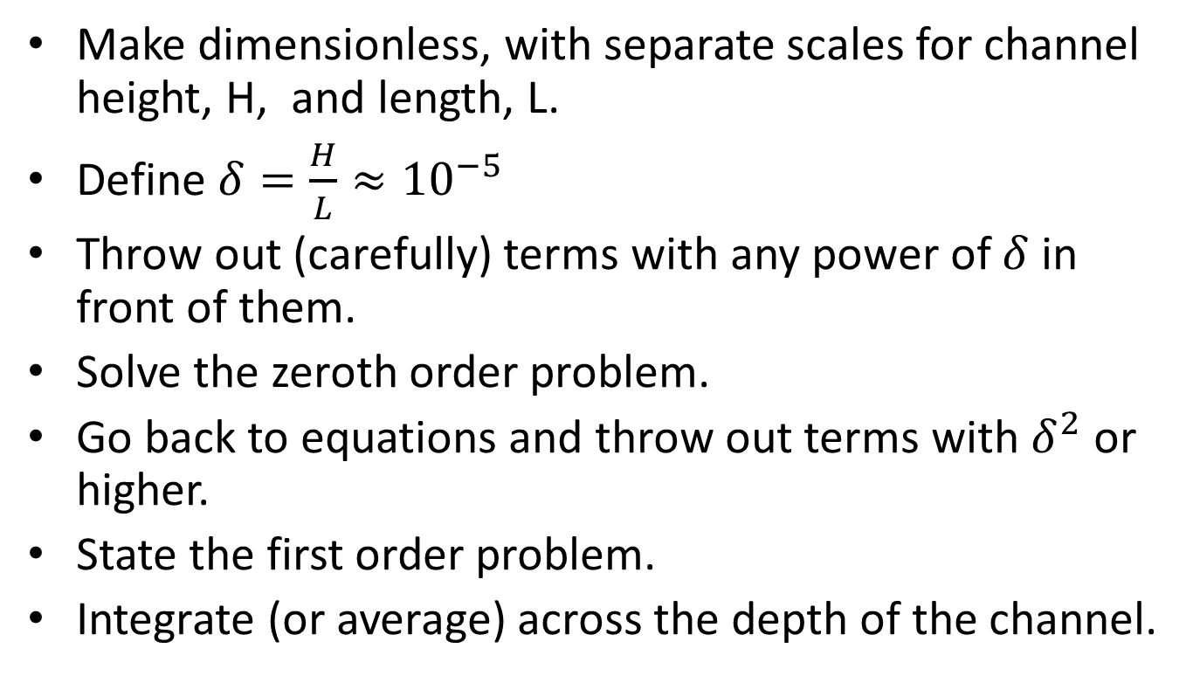
Analysis procedure
Make dimensionless, with separate scales for channel height, H, and length, L.
Define $δ=\frac{H}{L}≈{10}^{−5}$
Throw out (carefully) terms with any power of $δ$ in front of them.
Solve the zeroth order problem.
Go back to equations and throw out terms with $δ^{2}$or higher.
State the first order problem.
Integrate (or average) across the depth of the channel.

Slide 29

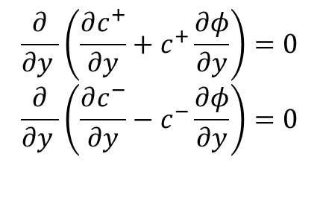
Zeroth order electrochemical equilibrium
$$\frac{∂}{∂y }\left(\frac{∂c^{+}}{∂y}+c^{+}\frac{∂φ}{∂y}\right)=0$$
$$\frac{∂}{∂y }\left(\frac{∂c^{−}}{∂y}−c^{−}\frac{∂φ}{∂y}\right)=0$$
$$c^{+}=c{(x)e}^{−φ}$$
$$c^{−}=c{(x)e}^{φ}$$
$$λ^{2}\frac{∂^{2}φ}{∂y^{2} }=c(x) sinh{φ}$$
Integrate w/ B.C.
Debye length/channel height. Constant ~ 0.1
Relative concentration at centerline,
Conc. of positive salt ions = negative
Once potential is solved for, concentration of salt ions, conductivity,
and charge density are known.

Slide 30
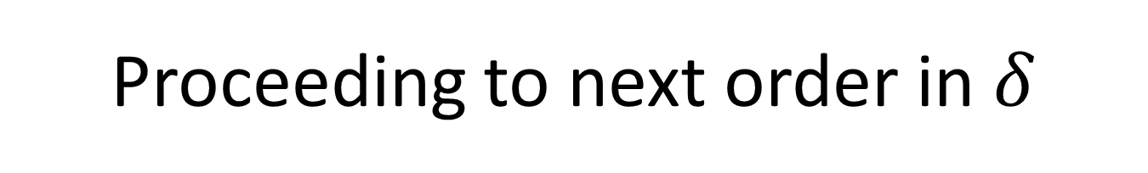
Proceeding to next order in $δ$
Flow is constant down the channel
Current is constant down the channel.
Conservation of electrical conductivity.
Conservation of sample species.
u is velocity
ρ is charge density
E is electric field
b is mobility (constant)
σ is electrical conductivity
n is concentration of sample
Bar denotes average taken across channel height

Slide 31
Assume distinct regions yields jump conditions
L1
L2
High cond.
Region 1
Low cond.
Region 2
High cond.
x=0
x=L

Slide 32

Total pressure & voltage drop
L1
L2
High cond.
Region 1
Low cond.
Region 2
High cond.
$$\overline{u}=−Eζ\left(1−\frac{\overline{φ}}{ζ}\right)+\frac{dP}{dx}\frac{1}{3}$$
Zeroth order velocity field
$\overline{u_{1}}=−\frac{{ΔV}_{1}}{L_{1}}ζ_{1}\left(1−\frac{\overline{φ_{1}}}{ζ}\right)+\frac{ΔP_{1}}{L_{1}}\frac{1}{3}={\overline{u}}_{2}=−\frac{{ΔV}_{2}}{L_{2}}ζ_{2}\left(1−\frac{\overline{φ_{2}}}{ζ}\right)+\frac{ΔP_{2}}{L_{2}}\frac{1}{3}$

Slide 33
Characteristics
1 micron
250 nm
Sample ions
Low conductivity
Sample ions
Low conductivity
Enhancement =13
Enhancement =125
10:1 Conductivity ratio, 1:10mM concentration

Slide 34
Why is nanoscale different?
y/H
High cond.
Low cond.
High cond.
y/H
High cond.
High cond.
Low cond.
y/H
Low cond.
High cond.
High cond.
X (mm)

Slide 35
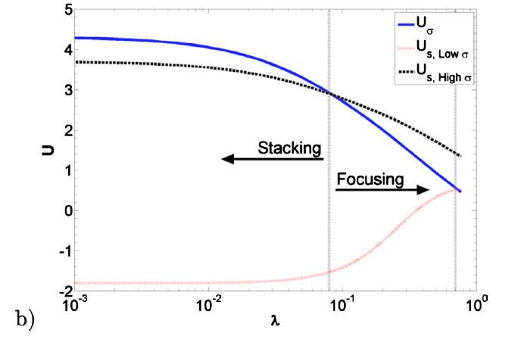
Focusing of sample ions
High cond. buffer
Low cond. buffer
High cond. buffer
Uσ
Us,high
Us,low
-
-
Uσ
Us,high
Us,low
Debye length/Channel Height

Slide 36
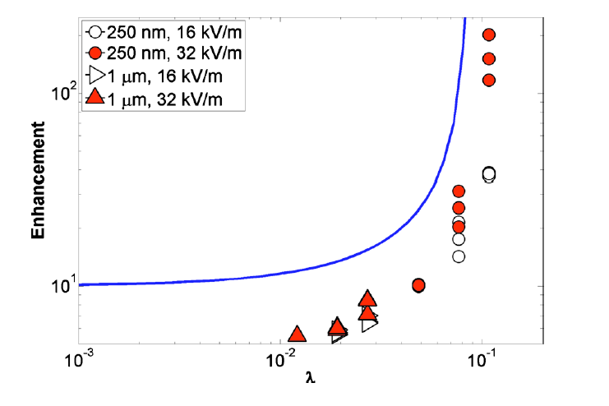
Simple model to experiment
Debye length/Channel Height
Simple model – 1D, single channel, no PDE, no free parameters

Slide 37
Focusing of conductivity characteristics finite interface
Low conductivity

Slide 38
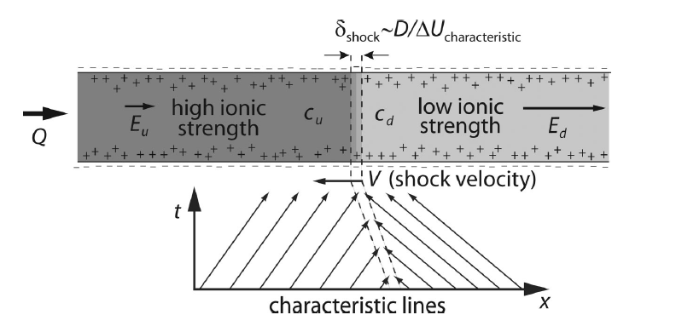
Shocks in background concentration
Mani, Zangle, and Santiago. Langmuir, 2009

Slide 39

Towards quantitative agreement
Add diffusive effects (solve a 1D PDE)
All four channels and sequence of voltages is critical in setting the initial contents of channel, and time dependent electric field in measurement channel.

Slide 40
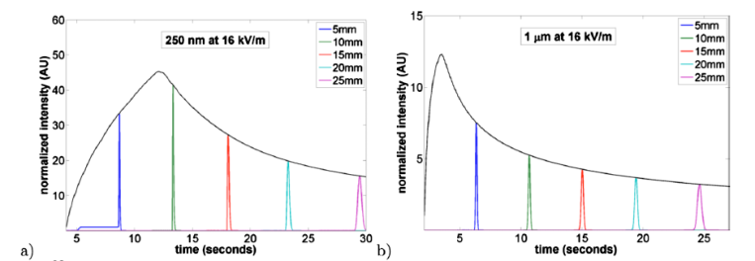
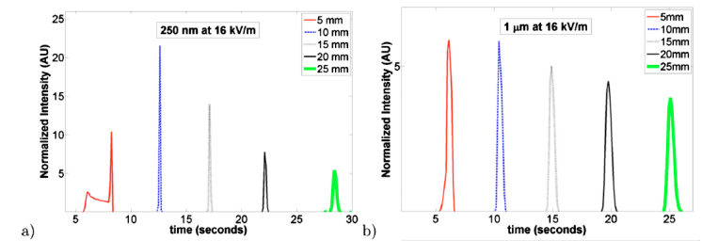
Model vs. experiment (16 kV/m)
250 nm
1 micron
Model
Exp.

Slide 41
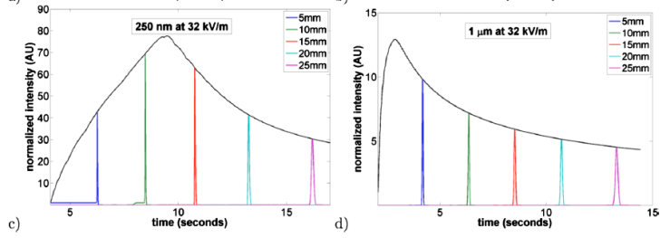
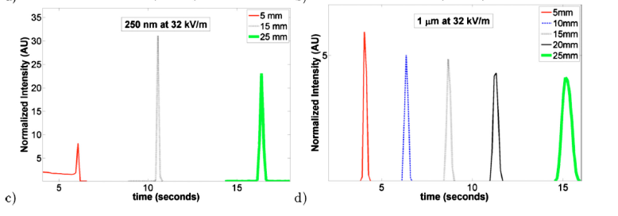
Model vs. experiment (32 kV/m)
250 nm
1 micron
Model
Exp.

Slide 42
Conclusions
Model is very simple, yet predicts all the key trends with no fit parameters.
Future work
  What is the upper limit?
  Can it be useful?
  More detailed model – better quantitative agreement.

Slide 43
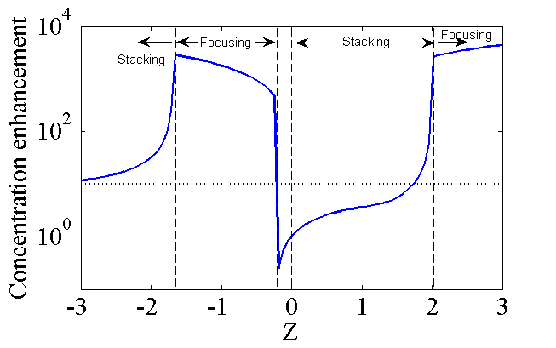
Untested predictions

Slide 44
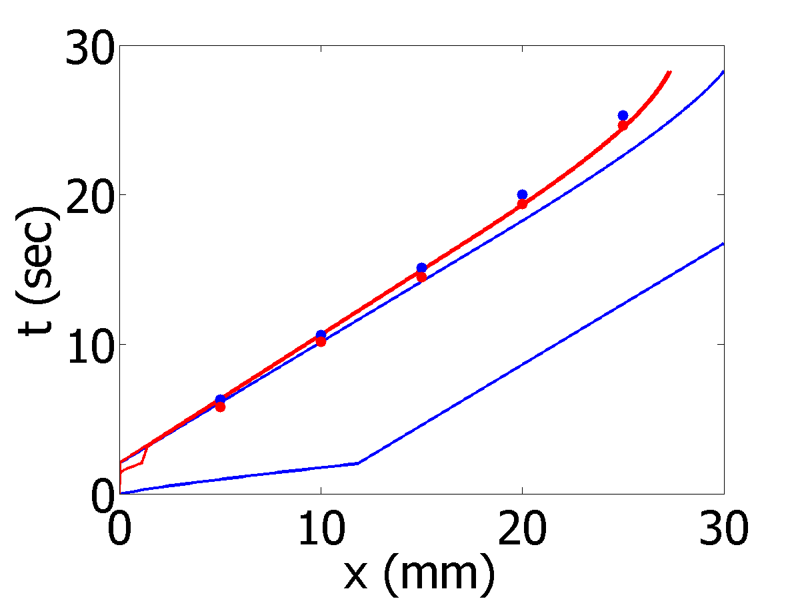
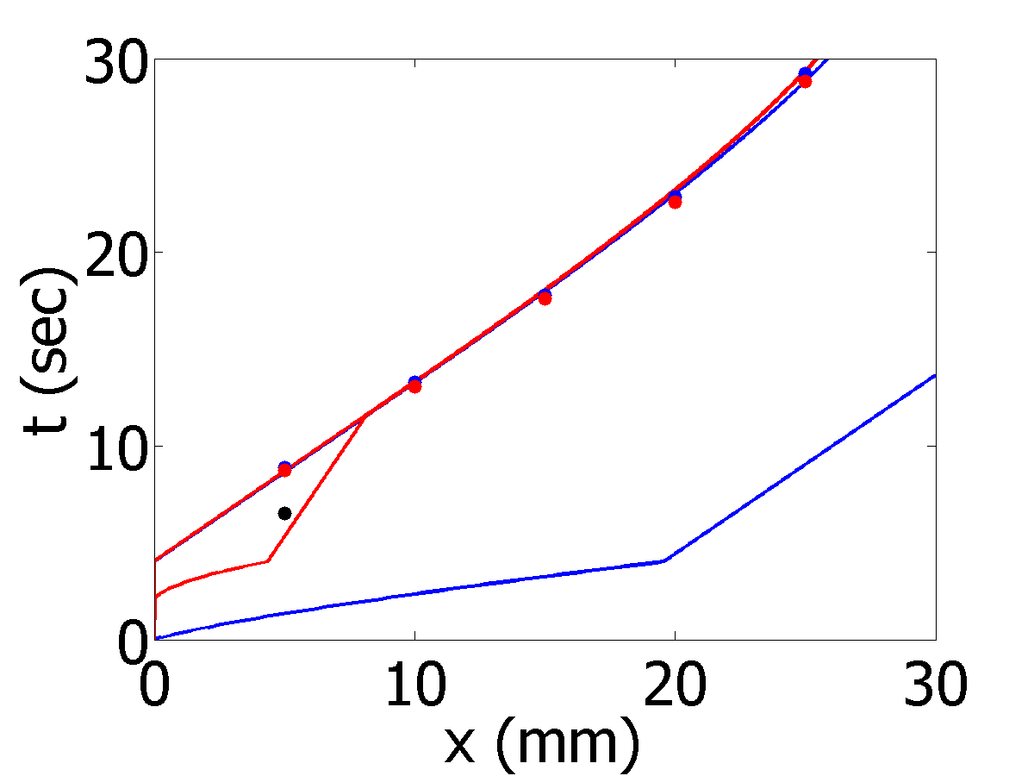
Characteristics – 4 channels
1 micron channel
250 nmchannel
Red – location of sample
Blue – location of low conductivity fluid

