Slide 1
Distribution of two miscible fluids at a T-junction:
Consequences for network flow
Casey Karst, Brian Storey, &
John Geddes
Olin College

Slide 2
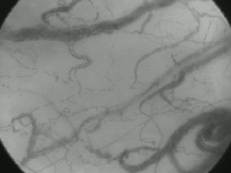
Heterogeneity in microvascular networks
Biology or property of networks?
“In single capillaries the flow may become retarded or accelerated from no visible cause; in capillary anastomoses (loops) the direction of flow may change from time to time. “
August Krogh 1922
Nobel Prize in Physiology, 1920
De Backer et al. “Microvascular Blood Flow Is Altered in Patients with Sepsis”
Am. J. of Respi. and Critical Care Med. (2002)
Notes:
In microvascular networks the flows and concentrations of cells are unsteady and unequal in different vessels. As Nobel Laurete August Krogh said “in single capillaries the flow may become retarded or accelerated from no visible cause; in capillary loops the direction of flow may change from time to time.”
A question asked by researchers in the past was whether this behavior was from biology or whether it was something inherit in fluidic networks. Simple blood networks have been analyzed to support idea that it is NOT biology. These researchers have found that there are two ingredients needed in order to have network heterogeneity: Non-linear viscosity and plasma skimming are required.

Slide 3
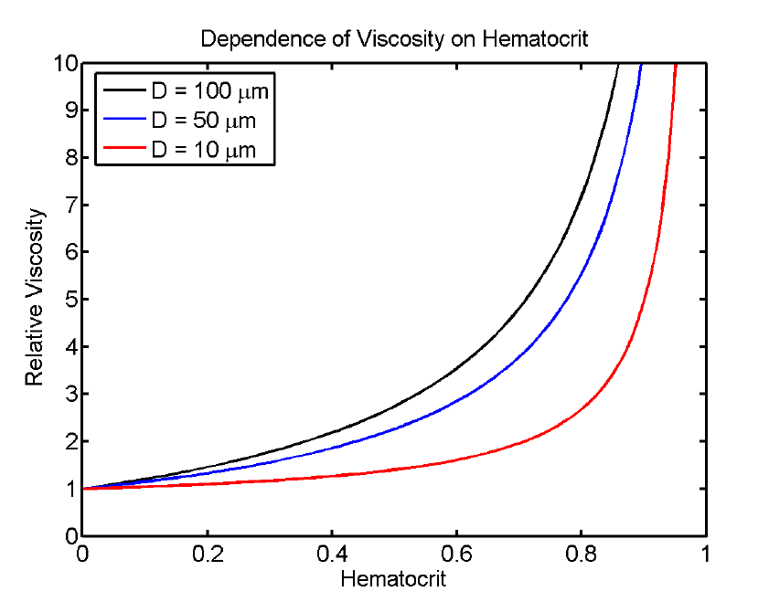
First ingredient for network heterogeneity non-linear viscosity
Volume fraction of RBCs
Geddes et al “The onset of oscillations in microvascular blood flow”
SIAM J Applied Dynamical Systems (2007).
Notes:
The first ingredient needed in order to obtain network heterogeneity is non linear viscosity. In

Slide 4
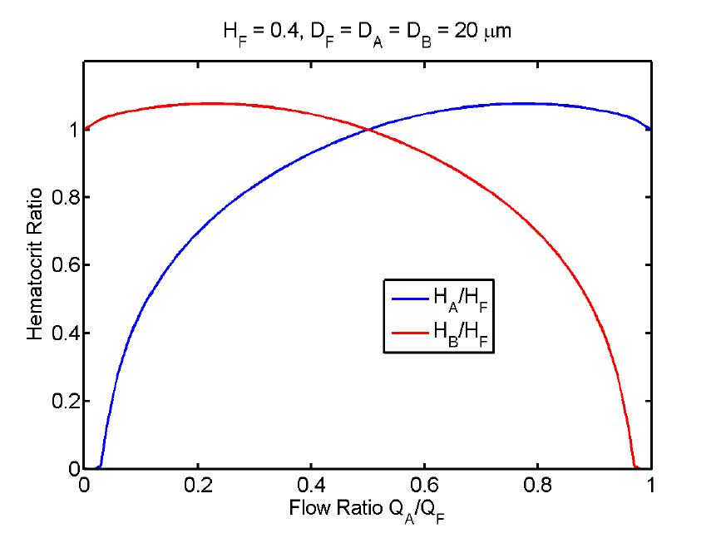
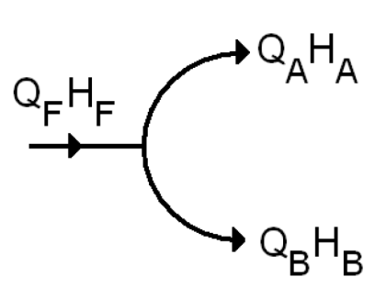
Second ingredient for network heterogeneity
“plasma skimming”
BLOOD
Volume fraction of RBCs
B
A
Flow ratio (Q_{A}/Q_{F})
Geddes et al “The onset of oscillations in microvascular blood flow”
SIAM J Applied Dynamical Systems (2007).
Notes:
Plasma skims. Don’t need to explain plot details.

Slide 5
These effects are general
Non-linear viscosity
  2 mixed Newtonian fluids (i.e. water and glycerol)
  2 phase Newtonian fluids (i.e. liquid-vapor)
  Non-Newtonian fluids
  Magma (i.e. viscosity dependent on water content)
“Plasma skimming” or phase separation
  Gas-liquid flows in process industry (50 yrs. of work)
  Liquid-liquid miscible fluids (oil industry)
  Liquid-vapor flows (refrigeration systems)
  Drops and bubbles in microfluidics
Notes:
Just the highlights

Slide 6
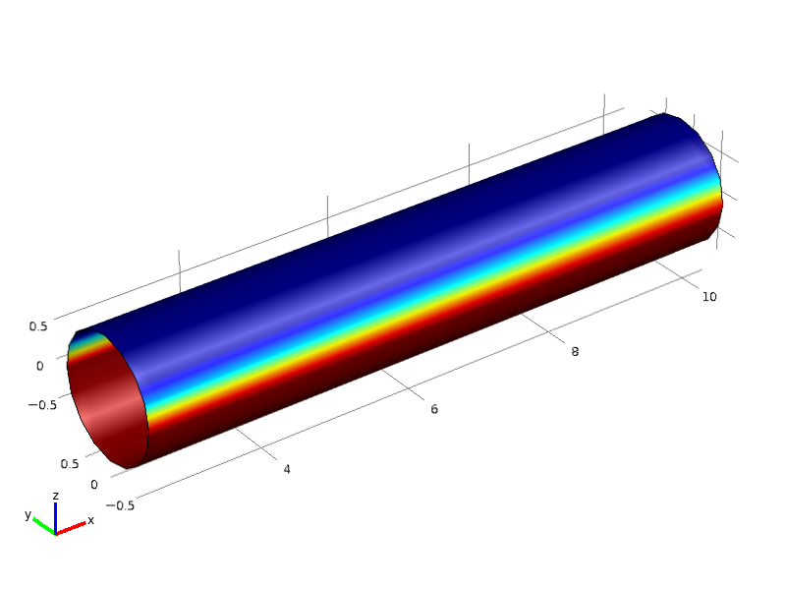
Our system – water and syrup
Stratified (density difference)
Laminar
Both are Newtonian
Different viscosity
Blue is water
Red is viscous, heavy syrup
Flow
gravity

Slide 7

Miscible stratified laminar flow non-linear viscosity
$$\frac{μ_{s}}{μ_{w}}=17$$
Effective resistance
Stratified,
immiscible
Fully mixed
Stratified,
miscible
Volume fraction of syrup

Slide 8
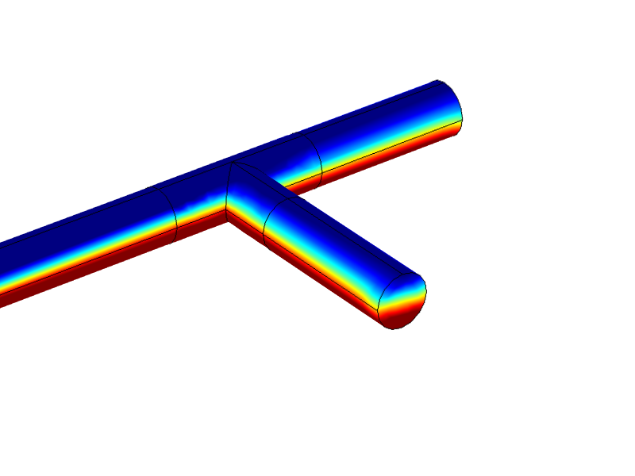
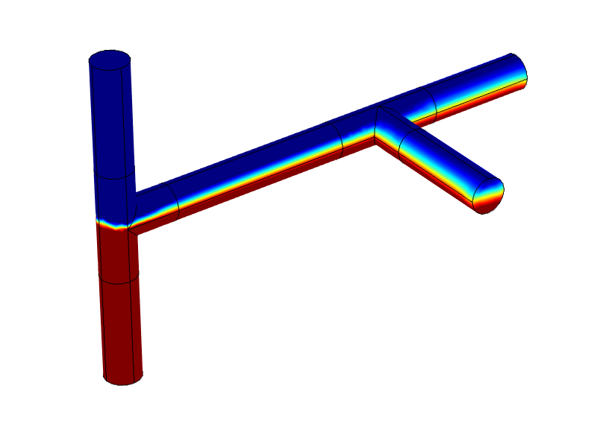
Does this system have phase separation?
Run
Inlet
Branch

Slide 9
Experimental setup
Pump,
water
Qin
Run
Pump,
outlet
Pump,
Syrup
Branch
Gravity points into the page.
P=0
Hold inlet flows. Vary outlet flow.
Measure contents of open outlet.
Switch outlet pump to branch and repeat.
Compare to 3D simulation (Comsol)

Slide 10
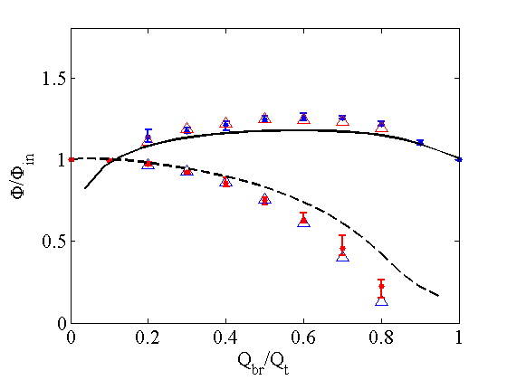
Typical data
Normalized volume fraction vs. flow in branch
15:1 viscosity ratio; 0.5 inlet volume fraction
Branch
Q_{t}, φ_{in}
Run
Run
Branch
Points are measured (3 trials)
Triangles are inferred (i.e. Branch can be inferred from run based on conservation)
Lines are simulations

Slide 11
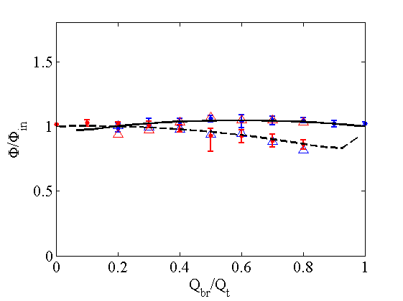
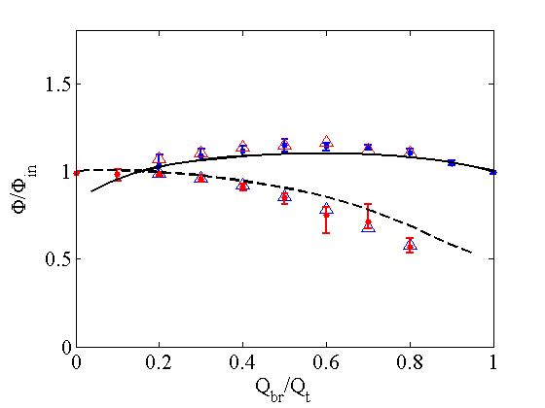
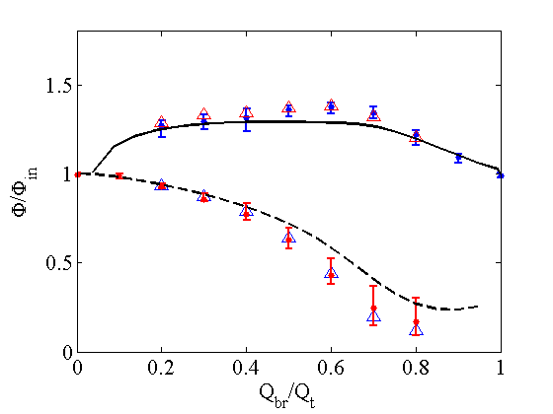
Function of total inlet flow
Branch
RE_{w}=6
RE_{s}=0.4
RE_{w}=12
RE_{s}=0.8
Run
RE_{w}=24
RE_{s}=1.6
RE_{w}=60
RE_{s}=4

Slide 12
Separation at equal flow ratios
Influence of other parameters

Slide 13
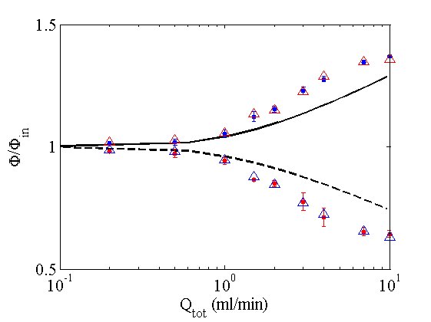
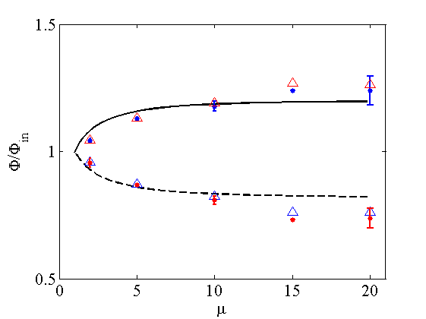
Phase separation at Q_{branch}/Q_{tot}=0.5
Re=6
Re=60
Branch
Branch
Run
Run

Slide 14
Consequence for networks
Gravity points into the page.
Pump,
water
Q1, 30% syrup
QC
Pump,
syrup
QA
P=0

Slide 15
Consequence for networks
Identical fluids on the inlets
Gravity points into the page.
Pump,
water
Pump,
water
Q1, 30% syrup
QC
Q2, 30% syrup
Pump,
syrup
Pump,
syrup
QA
QB
P=0
P=0

Slide 16
Bistability exists
Identical fluids on the inlets
Prediction
Experiment
Just water
Preliminary measurements

Slide 17
Additional tube – additional DOF
Identical fluids on the inlets
Gravity points into the page.
Pump,
water
Pump,
water
Q1
QC
Q2
QA
QB
QF
Pump,
syrup
QE
Pump,
syrup
QD
P=0
P=0

Slide 18
1, 3, 5, 7, or 9 Equilibrium states
Preliminary analysis

Slide 19
Conclusions
2-fluid miscible laminar flow of Newtonian fluids in networks is non-trivial.
  A good system for studying network flows since it is easily controlled and modeled.
We have measured phase separation for miscible laminar flow for the first time.
  Large literature on air-liquid system and turbulent-immiscible fluids due to industrial relevance.
System supports multiple equilibrium in simple networks.
  Ramifications for microfluidics.
  Increased complexity as network becomes more connected.
Core annular viscous flow might be better model for microvascular networks.
  Previous work on blood flow in general considers blood as two phases of different viscosity.
  Our preliminary Comsol simulations show plasma skimming like that measured in blood.
Future work - the hunt for dynamics.

