Slide 1
Inventory Control of Multiple Items Under Stochastic Prices and Budget Constraints
David Shuman, Mingyan Liu, and Owen Wu
University of Michigan
INFORMS Annual Meeting
October 14, 2009

Slide 2
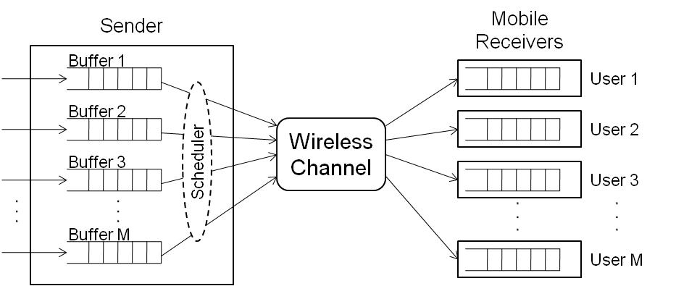
Motivating Application: Wireless Media Streaming
Key Features
Single source transmitting data streams to multiple users over a shared wireless channel
Available data rate of the channel varies with time and from user to user
Two Control Objectives
Avoid underflow, so as to ensure playout quality
Minimize system-wide power consumption
Opportunistic Scheduling
Exploit temporal and spatial variation of the channel by transmitting more data when channel condition is “good,” and less data when the condition is “bad”
Challenge is to determine what is a “good” condition, and how much data to send accordingly

Slide 3
Problem Description
Timing in Each Slot
Transmitter learns each channel’s state through a feedback channel
Transmitter allocates some amount of power (possibly zero) for transmission to each user
Total power allocated in any slot cannot exceed a power constraint, P
Transmission and reception
Packets removed/purged from each receiver’s buffer for playing
Each user’s per slot consumption of packets is constant over time, d^{m}
Transmitter knows each user’s packet requirements
Packets transmitted during a slot arrive in time to be played in the same slot
The available power P is always sufficient to transmit packets to cover one slot of playout for each user
Notes:
Remind that there are M users, single transmitter, and available data rate for transmission to each user varies across time and from user to user

Slide 4
Toy Example – Two Statistically Identical Receivers
Power constraint, P=12
3 possible channel conditions for each receiver:
Poor (60%)
Medium (20%)
Excellent (20%)
Mobile Receivers
User 1
Current Channel Condition: Medium
Power Cost per Packet: 4
User 2
Base Station / Scheduler
Current Channel Condition: Medium
Power Cost per Packet: 4
0
5
8
5
Total Power Consumed:
Time Remaining:

Slide 5
Toy Example – Two Statistically Identical Receivers
Power constraint, P=12
3 possible channel conditions for each receiver:
Poor (60%)
Medium (20%)
Excellent (20%)
Mobile Receivers
User 1
Current Channel Condition: Poor
Power Cost per Packet: 6
User 2
Base Station / Scheduler
Current Channel Condition: Excellent
Power Cost per Packet: 3
8
4
20
4
Total Power Consumed:
Time Remaining:

Slide 6
Toy Example – Two Statistically Identical Receivers
Power constraint, P=12
3 possible channel conditions for each receiver:
Poor (60%)
Medium (20%)
Excellent (20%)
Mobile Receivers
User 1
Current Channel Condition: Excellent
Power Cost per Packet: 3
User 2
Base Station / Scheduler
Current Channel Condition: Poor
Power Cost per Packet: 6
20
3
29
3
Total Power Consumed:
Time Remaining:

Slide 7
Toy Example – Two Statistically Identical Receivers
Power constraint, P=12
3 possible channel conditions for each receiver:
Poor (60%)
Medium (20%)
Excellent (20%)
Mobile Receivers
User 1
Current Channel Condition: Poor
Power Cost per Packet: 6
User 2
Base Station / Scheduler
Current Channel Condition: Poor
Power Cost per Packet: 6
29
2
35
2
Total Power Consumed:
Time Remaining:

Slide 8
Toy Example – Two Statistically Identical Receivers
Power constraint, P=12
3 possible channel conditions for each receiver:
Poor (60%)
Medium (20%)
Excellent (20%)
Mobile Receivers
User 1
Current Channel Condition: Poor
Power Cost per Packet: 6
Reduced power cost per packet from 5.0 under naïve transmission policy to 4.1, by taking into account:
(i) Current channel conditions
(ii) Current queue lengths
(iii) Statistics of future channel conditions
User 2
Base Station / Scheduler
Current Channel Condition: Poor
Power Cost per Packet: 6
35
1
41
1
41
0
Total Power Consumed:
Time Remaining:

Slide 9
Outline
Motivating Application: Wireless Media Streaming
Relation to Inventory Theory
Problem Formulation
Structure of Optimal Policy
Single Receiver
Two Receivers
Ongoing Work and Summary of Contributions

Slide 10
Relation to Inventory Theory
In inventory language, our problem is a multi-period, multi-item, discrete time inventory model with random ordering prices, deterministic demand, and a budget constraint
Items / goods → Data streams for each of the mobile receivers
Inventories → Receiver buffers
Random ordering prices → Random channel conditions
Deterministic demand → Users’ packet requirements for playout
Budget constraint → Transmitter’s power constraint
Notes:
You can imagine you are running a manufacturing plant, and you know how much of each basic commodity (copper, aluminum, etc.) you use each month. The prices change for each product every month, and you have a limited budget in any given month. You must make purchasing decisions.
Literature started in mid 1960s, and is still an active research area
This is a sample – there are others
Of the first category, Kingsman only one to consider a resource constraint, and his resource constraint, but it is on maximum number of items that may be ordered in each slot, which is constant over time
We leverage some of the proof techniques presented in these papers

Slide 11
Related Work in Inventory Theory
Single item inventory models with random ordering prices (commodity purchasing)
B. G. Kingsman (1969); B. Kalymon (1971); V. Magirou (1982); K. Golabi (1982, 1985)
Kingsman is only one to consider a capacity constraint, and his constraint is on the number of items that can be ordered, regardless of the random realization of the ordering price
Capacitated single and multiple item inventory models with stochastic demands and deterministic ordering prices
Single: A. Federgruen and P. Zipkin (1986); S. Tayur (1992)
Multipe: R. Evans (1967); G. A. DeCroix and A. Arreola-Risa (1998); C. Shaoxiang (2004);
G. Janakiraman, M. Nagarajan, S. Veeraraghavan (working paper, 2009)
To our knowledge, no prior work on multiple items with stochastic pricing and budget constraints
Notes:
You can imagine you are running a manufacturing plant, and you know how much of each basic commodity (copper, aluminum, etc.) you use each month. The prices change for each product every month, and you have a limited budget in any given month. You must make purchasing decisions.
Literature started in mid 1960s, and is still an active research area
This is a sample – there are others
Of the first category, Kingsman only one to consider a resource constraint, and his resource constraint, but it is on maximum number of items that may be ordered in each slot, which is constant over time
We leverage some of the proof techniques presented in these papers

Slide 12
Finite and Infinite Horizon Problem Formulation Cost Structure, Information State, and Action Space
Cost Structure
Linear ordering costs
is a random variable describing power consumption per unit of data transmitted to user m at time n
Linear holding costs
Per packet per slot holding cost h^{m} assessed on all packets remaining in user m’s receiver buffer after playout consumption
Information State
= vector of inventories (receiver queue lengths) at time n
= vector of prices (channel conditions) for slot n
Action Space
Defined in terms of Y_{n}, inventories (receiver queue lengths) after ordering
Must satisfy strict underflow constraints and budget (power) constraint
Notes:
Mention that we formulate problem for multiple user case, even though most of our results to date are for single user problem
Linear power rate typically assumed in low SNR regimes; would usually assume convex power-rate curve in high SNR regimes
Recall that the c_max constants must satisfy sum over m, d^m times c-max^m less equal to power constraint P
It will become apparent in a few slides why we have written action space as amount at end rather than transmitted quantity

Slide 13
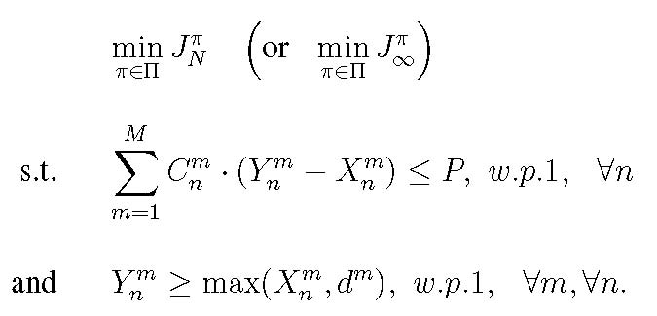
Finite and Infinite Horizon Problem Formulation System Dynamics, Optimization Criteria, and Optimization Problems
System Dynamics
Stochastic prices independently and identically distributed across time, and independent across items
Optimization Criteria
Finite horizon expected discounted cost criterion:
Infinite horizon expected discounted cost criterion:
Optimization Problems
Notes:
In both problems, the minimization is over the space of all randomized and deterministic history-dependent control laws

Slide 14
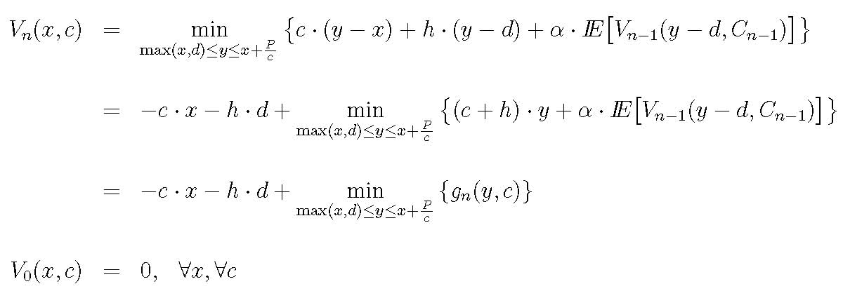
Single Item (User) Case Finite Horizon Problem
Dynamic Programming Equations
By induction, g_{n}(•,c) convex for every n and c, with lim_{y→∞} g_{n}(y,c) = ∞
If action space were independent of x, we would have a base-stock policy
Instead, we get a modified base-stock policy
Notes:
Pull out term that depends on x
G convex in y with lim as y goes to infinity equals to infinity, so it has a finite minimizer
Base-stock policy – order up to critical number, i.e., y_n^* is constant (independent of x)

Slide 15
Single Item (User) Case Structure of Optimal Policy
Theorem
For every n ∈ {1,2,…,N} and c ∈ C, there exists a critical number, b_{n}(c), such that the optimal control strategy is given by , where
Furthermore, for a fixed n, b_{n}(c) is nonincreasing in c, and for a fixed c: .
Graphical representation of optimal ordering (transmission) policy
Optimal Order Quantity
Optimal Inventory Level After Ordering
Inventory Level Before Ordering
Inventory Level Before Ordering
Notes:
Proof of structure based on convexity of g and Karush result – 1959 – a theorem in convex programming – naval research logistics quarterly
Monotonicity statements follow from submodularity arguments
Natural question to ask, can we find explicit form for critical numbers

Slide 16
Single Item (User) Case Other Results
The basic modified base-stock structure is preserved if we:
Allow the holding cost function to be a general convex, nonnegative, nondecreasing function
Model the per item ordering cost (channel condition) as a homogeneous Markov process
Take the deterministic demand sequence to be nonstationary
Replace the strict underflow constraints with backorder costs
Complete characterization of the finite horizon optimal policy
If (i) the number of possible ordering costs (channel conditions) is finite, and
(ii) for every condition c, L(c):=P/(c•d) is an integer,
then we can recursively define a set of thresholds that determine the critical numbers
Process is far simpler computationally than solving the dynamic program
The infinite horizon optimal policy is the natural extension of the finite horizon optimal policy
Stationary modified base-stock policy characterized by critical numbers , where

Slide 17
Two Item (User) Case Structure of Optimal Policy
For a fixed vector of channel conditions, c, there exists an optimal policy with the structure below
Inventory Level of Item 2 Before Ordering
Inventory Level of Item 1 Before Ordering
Show by induction that at every time n, for every fixed vector of channel conditions c, g_{n}(y,c) is convex and supermodular in y
b_{n}(c¹,c²) is a global minimum of g_{n}(•,c)

Slide 18
Two Item (User) Case Comparison to Evans’ Problem
Stochastic prices, fixed realization of c
Deterministic prices (constant c), Evans, 1967
Inventory Level of Item 2 Before Ordering
Inventory Level of Item 2 Before Ordering
Inventory Level of Item 1 Before Ordering
Inventory Level of Item 1 Before Ordering
Two key differences:
In addition to convexity and supermodularity, Evans showed the dominance of the second partials over the weighted mixed partials:
- Without differentiability, strict convexity assumptions of Evans, can use submodularity of g in the direct value order (E. Antoniadou, 1996)

Slide 19
Two Item (User) Case Comparison to Evans’ Problem
Stochastic prices, fixed realization of c
Deterministic prices (constant c), Evans, 1967
Inventory Level of Item 2 Before Ordering
Inventory Level of Item 2 Before Ordering
Inventory Level of Item 1 Before Ordering
Inventory Level of Item 1 Before Ordering
Two key differences:
In addition to convexity and supermodularity, Evans showed the dominance of the second partials over the weighted mixed partials:
- Without differentiability, strict convexity assumptions of Evans, can use submodularity of g in the direct value order (E. Antoniadou, 1996)
(ii) Different ordering costs lead to different target levels (global minimizers)
Key takeaway: lower left region is not a “stability region,” making the problem harder

Slide 20
Ongoing Work and Summary
Ongoing Work
Numerical approximations and resulting intuition for general M-item problem
Piecewise linear convex ordering cost (finite generalized base-stock policy)
Average cost criterion
Contribution to Wireless Communications
Analyze the specific streaming model
Introduce use of inventory models with stochastic ordering costs
Extend the literature on inventory models with stochastic ordering costs and budget constraints
No previous work with multiple items
Some results from models with stochastic demand, deterministic ordering costs “go through” in an adapted manner
e.g. single item modified base-stock policy, with one critical number for each price
However, some techniques and results do not go through
e.g., computation of critical numbers, direct value order submodularity of g in 2 item problem, “stability” region in 2 item problem
Contribution to Inventory Theory

Slide 21
Backup Slides

Slide 22
Submodularity in the Direct Value Order
Submodular
Direct Value Order (c,1) Submodular
Direct Value Order (c,2) Submodular

Slide 23
Single User Case Complete Characterization of Optimal Policy
Additional Technical Assumptions
Set of possible channel conditions is finite: C = { c₁,c₂,…,c_{K} }
Receiver buffer empty at beginning of time horizon
is an integer
Define Thresholds Recursively
For j=1, define g_{n,j} = ∞ ; for j>n, define g_{n,j} = 0
For 2 ≤ j ≤ n, define
Interpretation: per packet power cost at which transmitting packets to cover playout requirements for j-1 slots and j slots results in same expected cost-to-go
Determine Critical Numbers
If g_{n,j+1} < c ≤ g_{n,j} , let b_{n}(c) = j ∙ d
g_{n,n+1} =0
g_{n,n}
g_{n,n-1}
g_{n,j+1}
g_{n,j}
g_{n,j-1}
g_{n,2}
g_{n,1} = ∞
c₁
c₂
c₃
b_{n}(c₁) = n ∙ d
b_{n}(c₂) = j ∙ d
b_{n}(c₃) = d
Notes:
With a few more technical assumptions, we can explicitly identify critical numbers
Here still, all costs are positive and C_K \leq \frac{P}{d} – ie., can transmit one slots worth of packets in worst channel condition
L represents number of slots worth of packets one can transmit under current channel condition
Threshold parameters – n element {1,2,…,N}; j is an integer
C_1 – best channel condition (lower cost) leads to highest critical number – want to transmit more under good channel conditions; opposite argument for c_3
\gama_n,1 = \infty implies c \leq \gamma_n,1 implies b_n(c) \geq d for all c
\gamma_n,n+1 = 0 < c implies b_n(c) \leq nd
This process sheds insight into structural properties of problem, and results in computationally simpler (tractable) solution
Intuition: these conditions cause system to always have enough packets to cover integer number of slots
23

Slide 24
Single User Case Example
N = 20 , d = 1 , h = .2 , P = 36 , α = .95
c₁ = 1 , c₂ = 2 , c₃ = 4.5 , c₄ = 9
Pr(c₁) = .12 , Pr(c₂) = .18 , Pr(c₃) = .3 , Pr(c₄) = .4
Problem Parameters
Thresholds and Critical Numbers
g_{3,4} =0.0
g_{3,3} =3.4
g_{3,2} =5.0
g_{3,1} = ∞
n = 3
b₃(c₁) =3
b₃(c₂) =3
b₃(c₃) =2
b₃(c₄) =1
g_{6,6} =1.5
g_{6,7} =0.0
g_{6,5} =1.9
g_{6,4} =2.5
g_{6,3} =3.4
g_{6,2} =5.0
g_{6,1} = ∞
n = 6
b₆(c₁) =6
b₆(c₂) =4
b₆(c₃) =2
b₆(c₄) =1
g_{9,8}=0.92
g_{9,6} =1.5
g_{9,9} =0.67
g_{9,10} =0.0
g_{9,7}=1.2
g_{9,5} =1.9
g_{9,4} =2.5
g_{9,3} =3.4
g_{9,2} =5.0
g_{9,1} = ∞
n = 9
b₉(c₁) =7
b₉(c₂) =4
b₉(c₃) =2
b₉(c₄) =1

Slide 25
Role of Constraints
May be forced to send data under poor channel conditions in order to comply with deadline constraints
Moreover, optimal policy calls for transmitting more packets under the same “medium” channel conditions in anticipation of the need to comply with these constraints in future slots
The closer the deadlines and the more deadlines it faces, the less “opportunistic” the scheduler can afford to be
Power constraints in each slot play a similar role
The optimal stock-up levels in our problem are at least as high as those in the unrestricted (no power constraint) case considered by Kingsman, Golabi
Conclusion: constraints shift the definition of what constitutes a “good” channel

