Slide 1
From Sleeping to Stockpiling: Energy Conservation via Stochastic Scheduling in Wireless Networks David Shuman
Doctoral Committee:
Prof. Mingyan Liu
Prof. Demosthenis Teneketzis
Prof. Achilleas Anastasopoulos
Prof. Owen Wu
Thesis Defense
March 19th, 2010

Slide 2
Introduction
Energy conservation is a key design issue in wireless networks in general, and specifically in wireless sensor networks
Such networks are intended to operate for long periods of time without human intervention, despite relying on battery power or energy harvesting
Energy-efficient design can help prolong network lifetime
Avoid the need for more expensive batteries
Transmitting with lower power also helps to limit interference to other network users

Slide 3
Related Work on Energy-Efficient Design of Wireless Networks
Our focus here is on network protocols, as opposed to hardware design
Two primary objectives considered
Minimize total energy consumption
Balance energy consumption across the network
Most common energy conservation techniques
Limiting the idle time of a radio
Limiting repeated retransmissions (e.g., [Zorzi and Rao, 1997])
Adjusting transmission powers, based on time-varying channel conditions
Aggregating data
Combine data of local sensors into a compressed set of meaningful info to reduce communication workload (e.g., [Intanagonwiwat et al., 2003],[Heinzelman et al., 2000])
Adjusting routing
Find minimum energy routes (e.g., [Singh et al., 1998])
Balance energy consumption, for instance by a rotating cluster-head [Heinzelman et al., 2000]
Sporadic sensing
e.g. smart sensor web technology for soil moisture measurements

Slide 4
Related Work on Energy-Efficient Design of Wireless Networks
Our focus here is on network protocols, as opposed to hardware design
Two primary objectives considered
Minimize total energy consumption
Balance energy consumption across the network
Most common energy conservation techniques
Limiting the idle time of a radio
Limiting repeated retransmissions (e.g., [Zorzi and Rao, 1997])
Adjusting transmission powers, based on time-varying channel conditions
Aggregating data
Combine data of local sensors into a compressed set of meaningful info to reduce communication workload (e.g., [Intanagonwiwat et al., 2003],[Heinzelman et al., 2000])
Adjusting routing
Find minimum energy routes (e.g., [Singh et al., 1998])
Balance energy consumption, for instance by a rotating cluster-head [Heinzelman et al., 2000]
Sporadic sensing
e.g. smart sensor web technology for soil moisture measurements

Slide 5
Limiting the Idle Time of a Radio
Chapter 2: Optimal Sleep Scheduling for a Wireless Sensor Network Node
First cause of idling: no data to communicate
Single wireless sensor node that can be put to sleep to conserve energy
Formulate finite horizon expected cost and infinite horizon average expected cost Markov decision problems to model the fundamental tradeoff between delay and energy consumption
Analyze dynamic programming equations to derive structural results on the optimal sleep scheduling policies for both formulations
Chapter 3: Dynamic Clock Calibration via Temperature Measurement
Second cause of idling: lack of synchronization due to an inaccurate timer in the sleep mode
Develop a novel method for a node to calibrate its own clock: occasionally waking up to measure the ambient temperature
Goal is to dynamically schedule a limited number of temperature measurements so as to improve the accuracy of the timer

Slide 6
Chapters 4-7 Energy-Efficient Transmission Scheduling with Strict Underflow Constraints
Problem Description and Opportunistic Scheduling
Problem Formulation and Relation to Inventory Theory
Single Receiver Case – Exploiting Temporal Diversity
Two Receiver Case – Exploiting Spatial and Temporal Diversity
Stochastic Versus Deterministic Prices in Inventory Theory
Ongoing Work: General M Receiver Case
Summary of Contribution

Slide 7
Energy-Efficient Transmission Scheduling with Strict Underflow Constraints
Motivating application: wireless media streaming
Key Features
Single source transmitting data streams to multiple users over a shared wireless channel
Available data rate of the channel varies with time and from user to user
Two Control Considerations
Avoid underflow, so as to ensure playout quality
Minimize system-wide power consumption

Slide 8
Problem Description
Timing in Each Slot
Transmitter learns each channel’s state through a feedback channel
Transmitter allocates some amount of power (possibly zero) for transmission to each user
Total power allocated in any slot cannot exceed a power constraint, P
Transmission and reception
Packets removed/purged from each receiver’s buffer for playing
Notes:
Remind that there are M users, single transmitter, and available data rate for transmission to each user varies across time and from user to user

Slide 9
Problem Description (cont.)
Key Modeling Assumptions
Sender always has data to transmit to each receiver
Receivers have infinite buffers
Slot duration within channel coherence time (condition constant over slot)
Each user’s per slot consumption of packets is constant over time, d^{m}
Transmitter knows these drainage rates
Packets transmitted during a slot arrive in time to be played in the same slot
The available power P is always sufficient to transmit packets to cover one slot of playout for each user
Notes:
Infinite buffer – decreasing cost of memory
Iid – also independent of other user’s channel conditions and of transmitter’s scheduling decisions
Constant demand – justified if the receiving buffer is drained at a constant rate at the MAC layer, before packets are decoded by the media player at the application layer. Also, similar techniques can be used to examine the non-stationary case
Power constraint – even when they are all in the worst condition

Slide 10
Toy Example – Two Statistically Identical Receivers
Power constraint, P=12
3 possible channel conditions for each receiver:
Poor (60%)
Medium (20%)
Excellent (20%)
Mobile Receivers
User 1
Current Channel Condition: Medium
Power Cost per Packet: 4
User 2
Base Station / Scheduler
Current Channel Condition: Medium
Power Cost per Packet: 4
0
5
8
5
Total Power Consumed:
Time Remaining:

Slide 11
Toy Example – Two Statistically Identical Receivers
Power constraint, P=12
3 possible channel conditions for each receiver:
Poor (60%)
Medium (20%)
Excellent (20%)
Mobile Receivers
User 1
Current Channel Condition: Poor
Power Cost per Packet: 6
User 2
Base Station / Scheduler
Current Channel Condition: Excellent
Power Cost per Packet: 3
8
4
20
4
Total Power Consumed:
Time Remaining:

Slide 12
Toy Example – Two Statistically Identical Receivers
Power constraint, P=12
3 possible channel conditions for each receiver:
Poor (60%)
Medium (20%)
Excellent (20%)
Mobile Receivers
User 1
Current Channel Condition: Excellent
Power Cost per Packet: 3
User 2
Base Station / Scheduler
Current Channel Condition: Poor
Power Cost per Packet: 6
20
3
29
3
Total Power Consumed:
Time Remaining:

Slide 13
Toy Example – Two Statistically Identical Receivers
Power constraint, P=12
3 possible channel conditions for each receiver:
Poor (60%)
Medium (20%)
Excellent (20%)
Mobile Receivers
User 1
Current Channel Condition: Poor
Power Cost per Packet: 6
User 2
Base Station / Scheduler
Current Channel Condition: Poor
Power Cost per Packet: 6
29
2
35
2
Total Power Consumed:
Time Remaining:

Slide 14
Toy Example – Two Statistically Identical Receivers
Power constraint, P=12
3 possible channel conditions for each receiver:
Poor (60%)
Medium (20%)
Excellent (20%)
Mobile Receivers
User 1
Current Channel Condition: Poor
Power Cost per Packet: 6
Reduced power cost per packet from 5.0 under naïve transmission policy to 4.1, by taking into account:
(i) Current channel conditions
(ii) Current queue lengths
(iii) Statistics of future channel conditions
User 2
Base Station / Scheduler
Current Channel Condition: Poor
Power Cost per Packet: 6
35
1
41
1
41
0
Total Power Consumed:
Time Remaining:

Slide 15
Opportunistic Scheduling
Exploit temporal and spatial variation of the channel by transmitting more data when channel condition is “good,” and less data when the condition is “bad”
Challenge is to determine what is a “good” condition, and how much data to send accordingly
Benefit of doing so is referred to as the “multiuser diversity gain,” introduced in context of analogous uplink problem [Knopp and Humblet, 1995]
Opportunistic scheduling problems often feature competing QoS constraints
Fairness constraints (e.g. temporal, proportional, utilitarian)
Delay or deadline constraints
...
Notes:
This problem falls into the general class of opportunistic scheduling problems, where the goal is to...
The benefit of doing so is often called the multiuser diversity gain, and was ...
...this diversity benefit can be leveraged to improve system throughput and reduce power consumptions
However, it maz often be the case that a single user or small group of users have the best available data rate at every time. So simply sending to the user with the highest rate would result in poor quality of service for many users. Thus, ...
Many notions of fairness have been studied. Some examples include...
Temporal – all users get equal transmission time allocation over long run
Proportional – scheduler considers performance relative to average channel conditions
Utilitiarian – focus on system performance rather than resource consumptions – aims at having all users achieve a similar performance from the user‘s viewpoint

Slide 16
Opportunistic Scheduling with Delay Considerations
Most opportunistic scheduling studies with delay considerations look at either
(i) Stability (“throughput optimal” policies)
[Tassiulas and Ephrimedes, 1993; Neely et al., 2003; Andrews et al., 2004; Shakkothai et al., 2004]
(ii) Average delay
[Collins and Cruz, 1999; Berry and Gallager, 2002; Rajan et al., 2004; Bhorkar et al., 2006; Kittipiyakul and Javidi, 2007; Agarwal et al., 2008, Goyal et al., 2008]
More appropriate for delay-sensitive applications such as streaming are tight delay constraints, also referred to as deadline constraints
[Uysal-Biyikoglu and El Gamal, 2004; Fu, Modiano, and Tsitsiklis, 2006; Chen, Mitra, and Neely, 2009; Lee and Jindal, 2009]
Strict underflow constraints in our problem can be interpreted as multiple deadline constraints, and they also introduce a notion of fairness
Notes:
This problem falls into the general class of opportunistic scheduling problems, where the goal is to...
The benefit of doing so is often called the multiuser diversity gain, and was ...
...this diversity benefit can be leveraged to improve system throughput and reduce power consumptions
However, it maz often be the case that a single user or small group of users have the best available data rate at every time. So simply sending to the user with the highest rate would result in poor quality of service for many users. Thus, ...
Many notions of fairness have been studied. Some examples include...
Temporal – all users get equal transmission time allocation over long run
Proportional – scheduler considers performance relative to average channel conditions
Utilitiarian – focus on system performance rather than resource consumptions – aims at having all users achieve a similar performance from the user‘s viewpoint

Slide 17
Chapters 4-7 Energy-Efficient Transmission Scheduling with Strict Underflow Constraints
Problem Description and Opportunistic Scheduling
Problem Formulation and Relation to Inventory Theory
Single Receiver Case – Exploiting Temporal Diversity
Two Receiver Case – Exploiting Spatial and Temporal Diversity
Stochastic Versus Deterministic Prices in Inventory Theory
Ongoing Work: General M Receiver Case
Summary of Contribution

Slide 18
Finite and Infinite Horizon Problem Formulation Power-Rate Curves
Low SNR Regime
Linear power-rate curve associated with each channel condition
Peak power constraint in each time slot
.
High SNR Regime
Power-rate curve commonly taken to be convex
Here, we consider a piecewise-linear convex power-rate curve associated with each channel
Peak power constraint in each time slot
Notes:
You can imagine you are running a manufacturing plant, and you know how much of each basic commodity (copper, aluminum, etc.) you use each month. The prices change for each product every month, and you have a limited budget in any given month. You must make purchasing decisions.
Literature started in mid 1960s, and is still an active research area
This is a sample – there are others
Of the first category, Kingsman only one to consider a resource constraint, and his resource constraint, but it is on maximum number of items that may be ordered in each slot, which is constant over time
We leverage some of the proof techniques presented in these papers

Slide 19
Finite and Infinite Horizon Problem Formulations Cost Structure, Information State, and Action Space
Cost Structure
Transmission power costs
is a random variable describing the channel condition of receiver m at time n
Transmission of z^{m} units of data to receiver m in channel condition s^{m} incurs a power cost of c^{m}(z^{m}, s^{m})
Holding costs associated with receiver m in each slot are a convex, nonnegative, nondecreasing holding cost function h^{m}(•) of the packets remaining in receiver m’s buffer after playout consumption
Information State
= vector of receiver buffer queue lengths
= vector of channel conditions for slot n
Action Space
Defined in terms of , number of packets transmitted
Must satisfy nonnegativity, strict underflow, and system-wide power constraints:
Notes:
Mention that we formulate problem for multiple user case, even though most of our results to date are for single user problem
Linear power rate typically assumed in low SNR regimes; would usually assume convex power-rate curve in high SNR regimes
Recall that the c_max constants must satisfy sum over m, d^m times c-max^m less equal to power constraint P
It will become apparent in a few slides why we have written action space as amount at end rather than transmitted quantity

Slide 20
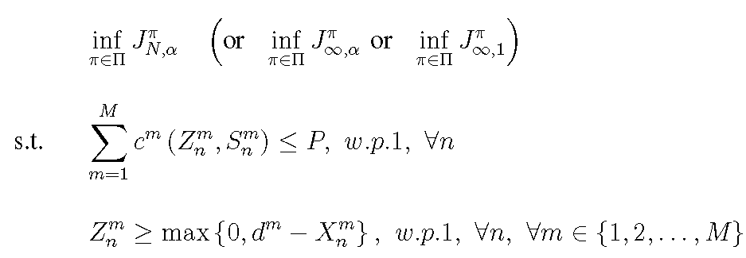
Finite and Infinite Horizon Problem Formulations System Dynamics, Optimization Criteria, and Optimization Problems
System Dynamics
is a homogeneous Markov process
Optimization Criteria
Finite horizon discounted expected cost criterion:
Infinite horizon discounted and average expected cost criteria:
and
Optimization Problems
Notes:
In both problems, the minimization is over the space of all randomized and deterministic history-dependent control laws

Slide 21
Relation to Inventory Theory
In inventory language, our problem is a multi-period, multi-item, discrete time inventory model with random ordering prices, deterministic demand, and a budget constraint
Items / goods → Data streams for each of the mobile receivers
Inventories → Receiver buffers
Random ordering prices → Random channel conditions
Deterministic demand → Drainage rate
Budget constraint → Transmitter’s power constraint
Notes:
You can imagine you are running a manufacturing plant, and you know how much of each basic commodity (copper, aluminum, etc.) you use each month. The prices change for each product every month, and you have a limited budget in any given month. You must make purchasing decisions.
Literature started in mid 1960s, and is still an active research area
This is a sample – there are others
Of the first category, Kingsman only one to consider a resource constraint, and his resource constraint, but it is on maximum number of items that may be ordered in each slot, which is constant over time
We leverage some of the proof techniques presented in these papers

Slide 22
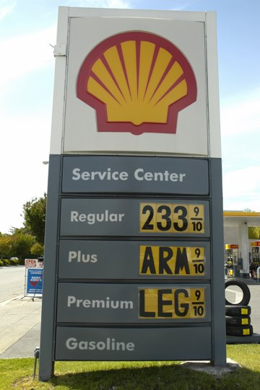
Optimizing the Life of a PhD student
Single item, budget constrained problem
You consume 1 gallon per day driving to and from work
Possible prices: $1.50, $1.75, $2.00, $2.25, $2.50, $2.75, $3.00, $3.25, $3.50
Cannot spend more than $6 on gas in a single day
Two item, budget constrained problem
In addition to consuming gas, you eat Ramen every day…
Possible prices per package: $0.16, $0.18, $0.20, $0.25
Cannot spend more than $8 on gas and Ramen in a single day
Lots of Ramen!
Notes:
You can imagine you are running a manufacturing plant, and you know how much of each basic commodity (copper, aluminum, etc.) you use each month. The prices change for each product every month, and you have a limited budget in any given month. You must make purchasing decisions.
Literature started in mid 1960s, and is still an active research area
This is a sample – there are others
Of the first category, Kingsman only one to consider a resource constraint, and his resource constraint, but it is on maximum number of items that may be ordered in each slot, which is constant over time
We leverage some of the proof techniques presented in these papers

Slide 23
Related Work in Inventory Theory
Single item inventory models with random ordering prices
B. G. Kingsman (1969); B. Kalymon (1971); V. Magirou (1982); K. Golabi
(1982, 1985)
Kingsman is only one to consider a capacity constraint, and his constraint is on the number of items that can be ordered, regardless of the random realization of the ordering price
Capacitated single and multiple item inventory models with stochastic demands and deterministic ordering prices
Single: A. Federgruen and P. Zipkin (1986); S. Tayur (1992);
Bensoussan et al (1983)
Multipe: R. Evans (1967); G. A. DeCroix and A. Arreola-Risa (1998);
S. Chen (2004); G. Janakiraman, M. Nagarajan, S. Veeraraghavan (2009)
To our knowledge, no prior work on single item models with stochastic piecewise-linear convex ordering costs or multiple item models with stochastic prices and budget constraints
Notes:
You can imagine you are running a manufacturing plant, and you know how much of each basic commodity (copper, aluminum, etc.) you use each month. The prices change for each product every month, and you have a limited budget in any given month. You must make purchasing decisions.
Literature started in mid 1960s, and is still an active research area
This is a sample – there are others
Of the first category, Kingsman only one to consider a resource constraint, and his resource constraint, but it is on maximum number of items that may be ordered in each slot, which is constant over time
We leverage some of the proof techniques presented in these papers

Slide 24
Chapters 4-7 Energy-Efficient Transmission Scheduling with Strict Underflow Constraints
Problem Description and Opportunistic Scheduling
Problem Formulation and Relation to Inventory Theory
Single Receiver Case – Exploiting Temporal Diversity
Two Receiver Case – Exploiting Spatial and Temporal Diversity
Stochastic Versus Deterministic Prices in Inventory Theory
Ongoing Work: General M Receiver Case
Summary of Contribution

Slide 25
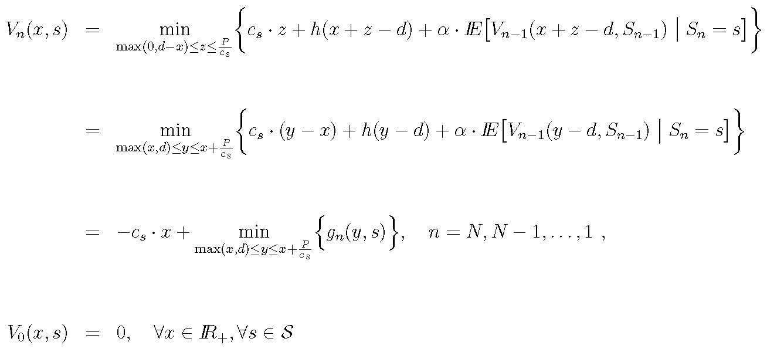
Single Receiver with Linear Power-Rate Curves Finite Horizon Problem
Dynamic Programming Equations
Uncountable state space and uncountable action space makes DP computationally intractable
If action space were independent of x, we would have a base-stock policy
Instead, we get a modified base-stock policy
Notes:
Pull out term that depends on x
G convex in y with lim as y goes to infinity equals to infinity, so it has a finite minimizer
Base-stock policy – order up to critical number, i.e., y_n^* is constant (independent of x)

Slide 26
Single Receiver with Linear Power-Rate Curves Modified Base-Stock Policy is Optimal
Theorem
For every n ∈ {1,2,…,N} and s ∈ S, there exists a critical number, b_{n}(s), such that the optimal control strategy is given by , where
Furthermore, for a fixed n, b_{n}(s) is nonincreasing in c_{s}, and for a fixed s: .
Graphical representation of optimal transmission policy
Optimal Number of Packets to Transmit
Optimal Buffer Level After Transmission
Buffer Level Before Transmission
Buffer Level Before Transmission
Notes:
Proof of structure based on convexity of g and Karush result – 1959 – a theorem in convex programming – naval research logistics quarterly
Monotonicity statements follow from submodularity arguments
Natural question to ask, can we find explicit form for critical numbers

Slide 27
Single Receiver with Piecewise-Linear Convex Power-Rate Curves Finite Generalized Base-Stock Policy is Optimal
Theorem
For every n ∈ {1,2,…,N} and s ∈ S, there exists a nonincreasing sequence of critical numbers,
{b_{n,k}(s)}_{k ∈ {0,1,…,K} ,} such that the optimal number of packets to transmit under channel condition s with n slots remaining is given by:
Graphical representation of optimal transmission policy
Optimal Number of Packets to Transmit
Optimal Buffer Level After Transmission
Buffer Level Before Transmission
Buffer Level Before Transmission
Notes:
Proof of structure based on convexity of g and Karush result – 1959 – a theorem in convex programming – naval research logistics quarterly
Monotonicity statements follow from submodularity arguments
Natural question to ask, can we find explicit form for critical numbers

Slide 28
Extensions of Single Receiver Results
The modified base-stock and finite generalized base-stock structures are preserved if we:
Take the deterministic demand sequences to be nonstationary
Replace the strict underflow constraints with appropriate penalties for violating the constraints
Complete characterization of the finite horizon optimal policy
If (i) the number of possible channel conditions (ordering costs) is finite,
(ii) the channel condition is IID,
(iii) the holding costs are linear (or zero), and
(iv) the maximum number of packets that can be transmitted is an integer multiple of the demand,
then we can recursively define a set of thresholds that determine the critical numbers
Process is far simpler computationally than solving the dynamic program
To our knowledge, this is first work to explicitly compute critical numbers for any type of finite generalized base-stock policy
The infinite horizon optimal policies are natural extensions of the finite horizon optimal policies

Slide 29
Chapters 4-7 Energy-Efficient Transmission Scheduling with Strict Underflow Constraints
Problem Description and Opportunistic Scheduling
Problem Formulation and Relation to Inventory Theory
Single Receiver Case – Exploiting Temporal Diversity
Two Receiver Case – Exploiting Spatial and Temporal Diversity
Stochastic Versus Deterministic Prices in Inventory Theory
Ongoing Work: General M Receiver Case
Summary of Contribution

Slide 30
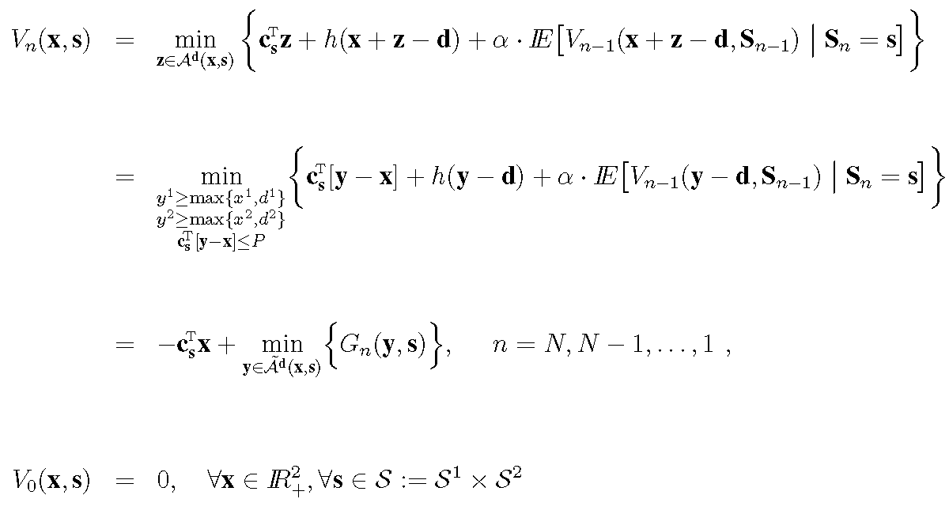
Two Receiver (Item) Case Analysis
Show by induction that at every time n, for every fixed vector of channel conditions s, G_{n}(y,s) is convex and supermodular in y
Define again b_{n}(s¹,s²) to be a global minimizer of G_{n}(•,s)

Slide 31
Two Receiver (Item) Case Structure of Optimal Policy
For a fixed vector of channel conditions, s, there exists an optimal policy with the following seven region structure
Key takeaway: The power constraint couples the optimal scheduling of the two streams

Slide 32
Chapters 4-7 Energy-Efficient Transmission Scheduling with Strict Underflow Constraints
Problem Description and Opportunistic Scheduling
Problem Formulation and Relation to Inventory Theory
Single Receiver Case – Exploiting Temporal Diversity
Two Receiver Case – Exploiting Spatial and Temporal Diversity
Stochastic Versus Deterministic Prices in Inventory Theory
Ongoing Work: General M Receiver Case
Summary of Contribution

Slide 33
Two Item Inventory Model with a Joint Resource Constraint and Deterministic Prices
Large majority of models in the classical inventory literature consider deterministic, time-invariant prices and stochastic demands – the reverse of our model
Variant of Evans’ (1967) problem considered in Chen (2004): 2 items, joint resource constraint, deterministic prices, stochastic IID demands with a general distribution, complete backlogging
At first glance, structure seems the same as our problem, but there are two fundamental differences

Slide 34
Comparison of Stochastic and Deterministic Price Inventory Models Fundamental Difference 1 – Functional Properties Lead to Additional Structure
Stochastic prices (fixed realization of s)
Deterministic prices
Inventory Level of Item 2 Before Ordering
Inventory Level of Item 2 Before Ordering
Inventory Level of Item 1 Before Ordering
Inventory Level of Item 1 Before Ordering
In addition to convexity and supermodularity, Evans showed the dominance of the second partials over the weighted mixed partials:
Without differentiability, strict convexity assumptions, we can show submodularity of G in the direct value orders [Antoniadou, 1996]

Slide 35
Deterministic Price Inventory Model Lower-left “Stability Region” and Separation Result
In infinite horizon problems, boundaries of seven regions are time-invariant
Vector of inventories eventually falls in green region
Once it does, it never leaves
Reframe problem in terms of shortfall to optimize constrained allocation and target levels separately [Janakiraman et al., 2009]
Inventory Level of Item 2 Before Ordering
Inventory Level of Item 1 Before Ordering

Slide 36
Comparison of Stochastic and Deterministic Price Inventory Models Fundamental Difference 2 – Time-Varying Target Levels
Inventory Level of Item 2 Before Ordering
Inventory Level of Item 1 Before Ordering

Slide 37
Chapters 4-7 Energy-Efficient Transmission Scheduling with Strict Underflow Constraints
Problem Description and Opportunistic Scheduling
Problem Formulation and Relation to Inventory Theory
Single Receiver Case – Exploiting Temporal Diversity
Two Receiver Case – Exploiting Spatial and Temporal Diversity
Stochastic Versus Deterministic Prices in Inventory Theory
Ongoing Work: General M Receiver Case
Summary of Contribution

Slide 38
Ongoing Work Numerical approximations and resulting intuition for general M-item problem
Approach: Lower bound value function and find a feasible policy whose performance is close to bound
Lower bounds
Power constraint of P per user in each slot (separable problem)
Lagrangian relaxation, which is equivalent to relaxing per-slot power constraint to average power constraint [Hawkins, 2003; Adelman and Mersereau, 2008]
Linear program relaxation by approximating value functions as linear combinations of some basis functions [Schweitzer and Seidmann, 1985; de Farias and van Roy, 2003; Adelman and Mersereau, 2008]
Information relaxation – assume you can use knowledge of future channel conditions at some cost [Brown, Smith, and Sun, 2009]
To generate a feasible policy
Heuristics based on structural results
One-step greedy optimization using approximate value functions resulting from lower bounds

Slide 39
Discussion Points
Deadline constraints shift the definition of what constitutes a “good” channel in opportunistic scheduling problems
May be forced to send data under poor channel conditions in order to comply with deadlines
Moreover, optimal policy calls for transmitting more packets under the same “medium” channel conditions in anticipation of the need to comply with constraints in future slots
The closer the deadlines and the more deadlines it faces, the less “opportunistic” the scheduler can afford to be
Stochastic price inventory models may feature fundamentally different structural phenomena than deterministic price inventory models and therefore merit their own line of analysis
Literature relatively thin compared to classical inventory setup
Some results for stochastic prices follow in an expected manner, but others do not
Perhaps new motivating applications in communications can continue to lead to theoretical developments

Slide 40
Discussion Points
Combination of structural results and numerical approximation techniques
Two most common reasons to search for structural results on the optimal policy:
Improve intuitive understanding of the problem
Enable efficient computation of the optimal policy through complete specification in closed form, faster algorithm than DP, or accelerate standard methods such as value and policy iteration by restricting the class of policies
In multi-item / multi-queue stochastic control problems, there is often a significant jump in complexity from 1 to 2 items, and another jump from 2 to M items
Numerical approximation techniques often search for lower bounds by finding a relaxation that decouples the high dimensional problem into multiple instances of low dimensional problems
Structural results on low dimensional problems can improve approximate numerical solutions to the related high dimensional problem

Slide 41
Summary of Contributions
Opportunistic scheduling with deadline constraints as a quality of service requirement and a notion of fairness
Single receiver – exploiting temporal diversity
Proved that an easily implementable modified base-stock policy is optimal under linear power-rate curves
Proved that a finite generalized base-stock policy is optimal under piecewise-linear convex power-rate curves
Identified a way to calculate the thresholds that complete the characterizations of the optimal policies, in the case that certain technical conditions are met
Two receivers – exploiting spatial and temporal diversity
Proved structure of optimal policy, which shows coupling between receivers
Made novel connection to inventory models with stochastic ordering costs
Connection and inventory techniques may be useful for other wireless transmission scheduling problems
Work also represents a contribution to inventory theory literature

